Slide 1



s2p: a modular Stereo Pipeline
Carlo de Franchis, Enric Meinhardt-Llopis, Julien Michel,
Jean-Michel Morel, Gabriele Facciolo
avec la participation de : B.Rougé, G. Blanchet, J.-M. Delvit, C. Latry, P. Cao, C. Tinel
P. Monasse, I. Rey Otero, L. Simon, R. Saffar, Z. Tang, P. Tan
Institut de physique du globe de Paris
14 novembre 2014

Slide 2
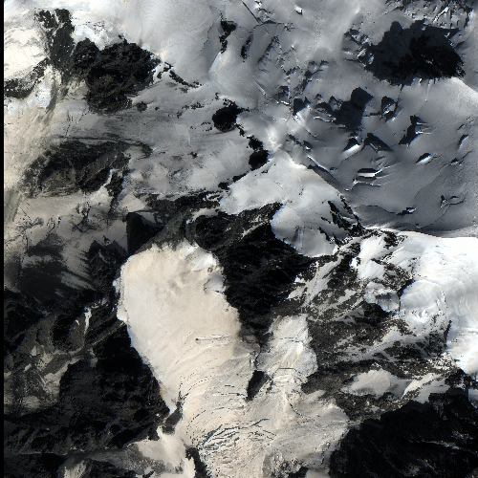

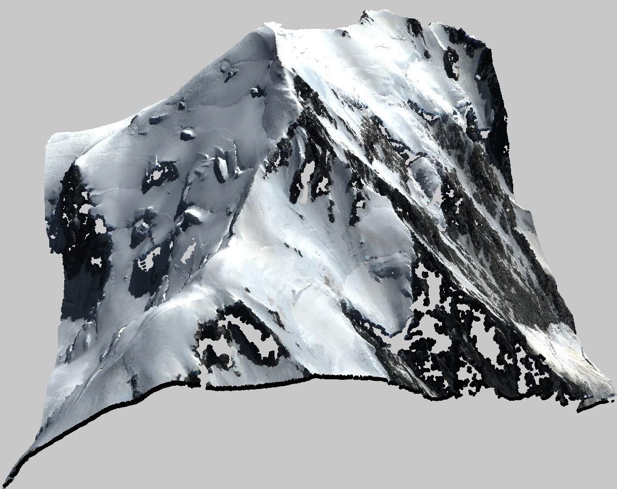
s2p: Satellite Stereo Pipeline
or
input
output

Slide 3
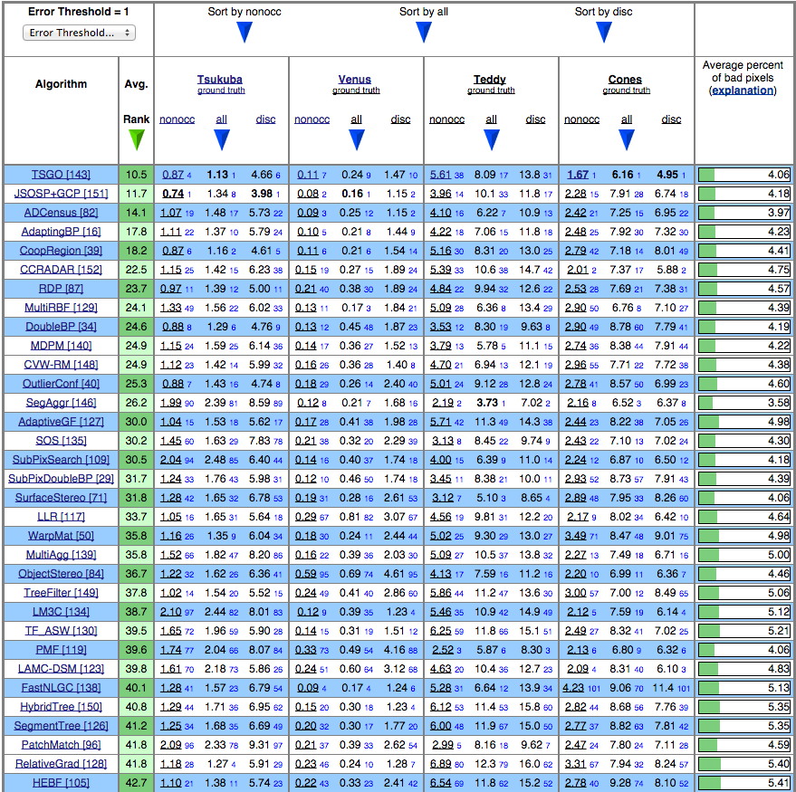
Why s2p ?
process pushbroom images with matching tools from the stereo vision community
more than 150 algorithms listed on Middlebury pages
all of them work with rectified stereo images

Slide 4




s2p alternatives
Commercial:
  Erdas Imagine
  PCI Geomatica
  Pixel Factory
  Agisoft Photoscan
  Smart3DCapture
Academic:
  no pushbroom:
    SURE
    PMVS2
    OpenMVG
  pushbroom:
    Micmac
    ASP
    COSI-Corr
no epipolar rectification

Slide 5
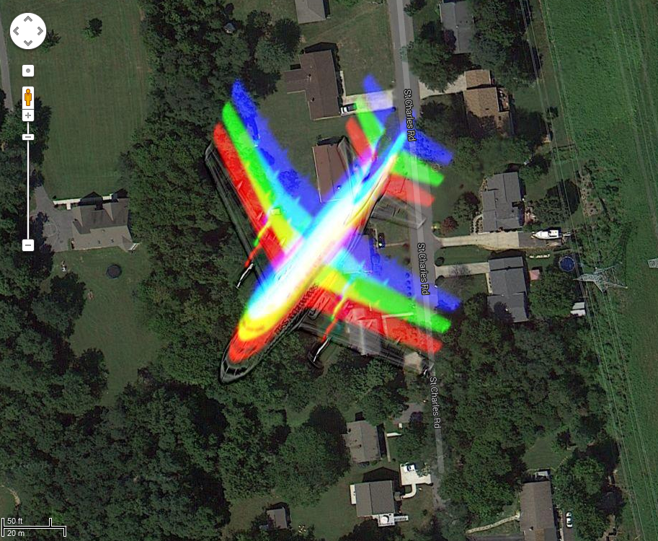
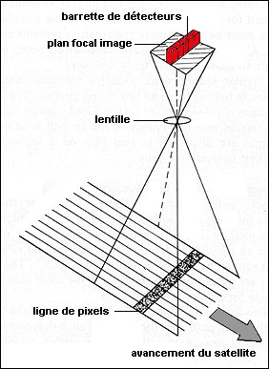
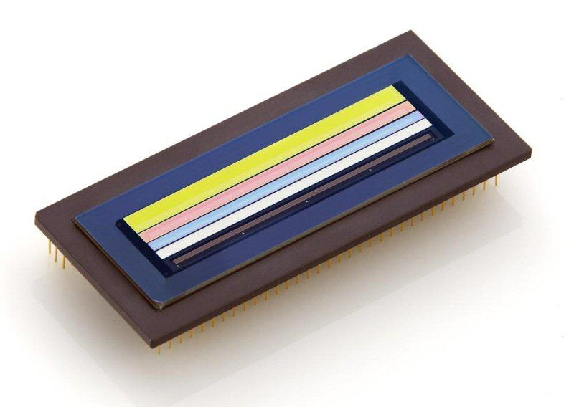
Pushbroom cameras aren’t pinhole
The mystery of rainbow airplanes
Problem: no epipolar rectification for pushbroom cameras
“Linear Pushbroom Cameras”, Hartley and Gupta, PAMI 1997

Slide 6
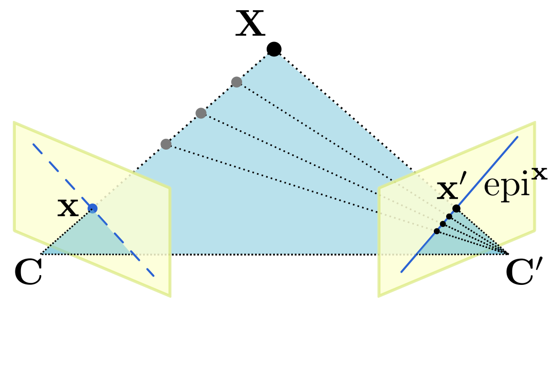
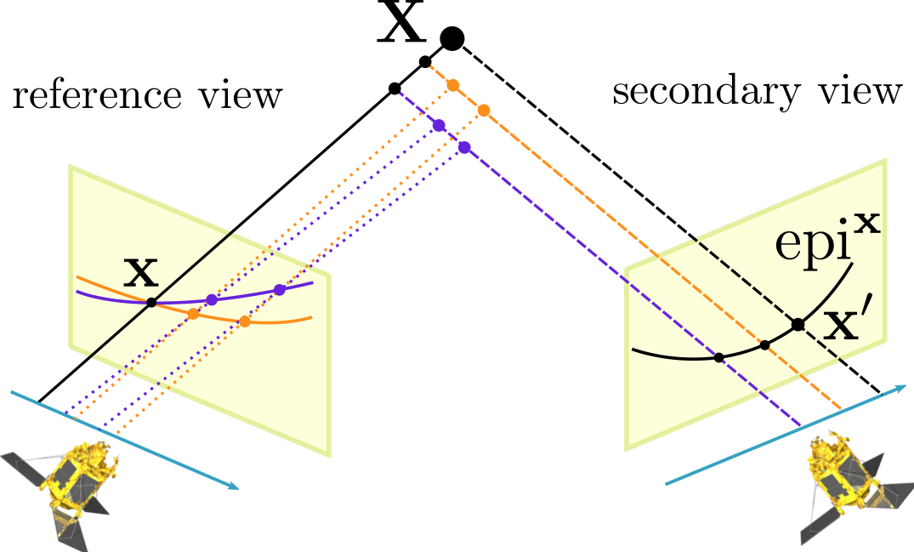
The epipolar rectification problem
Pinhole
Pushbroom
ruled quadric
plane

Slide 7
Why epipolar rectification?
To reduce matching exploration from 2D to 1D.
Consequences:
rectified images are an intermediate product,
there is no need for large rectified images,
we can use small tiles!

Slide 8
Local epipolar rectification
Sensor far away from scene: 700 km (Pléiades)
Moreover, on a 1km x 1km tile:
ground altitude differences: < 1 km
narrow angular field of view: < 0.1°
short acquisition time: < 0.2 s
  sensor traveled distance: < 2 km
Consequence: the camera behaves as an affine camera thus the tiles can be rectified.

Slide 9
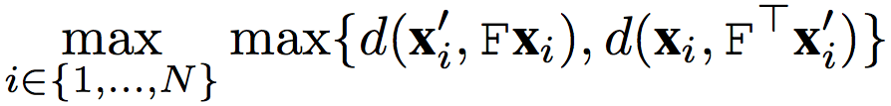
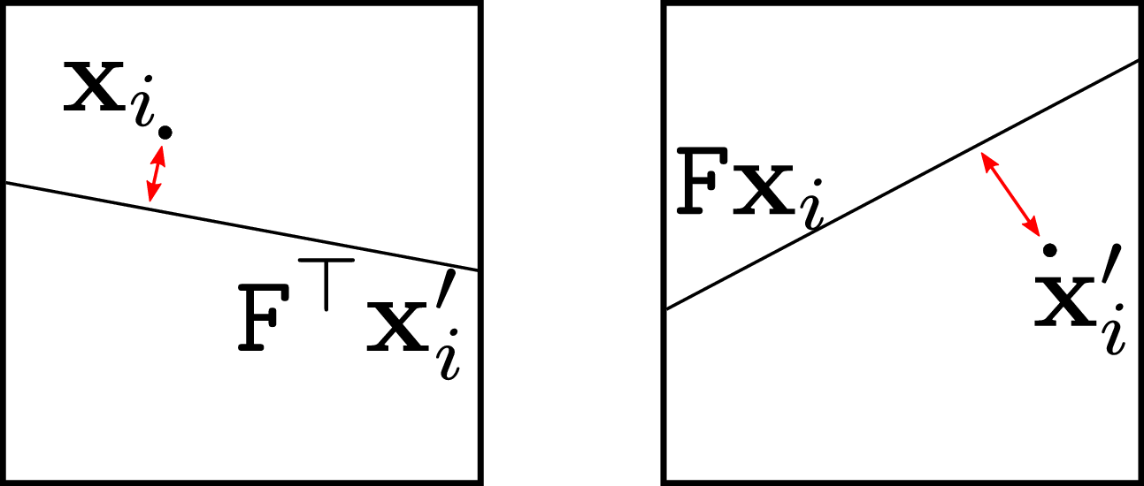
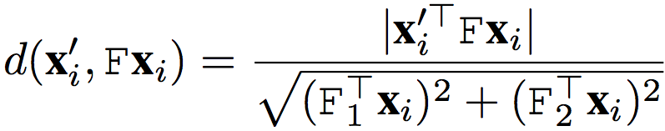
Validation of the local rectification
error:
: fundamental matrix

Slide 10
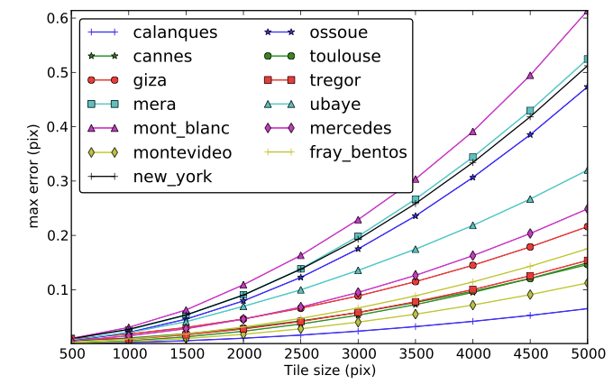
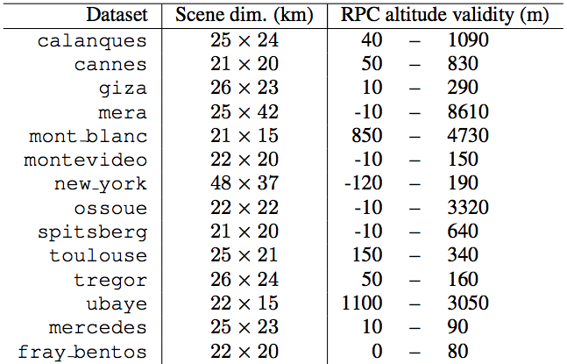
Conclusions on rectification
With 1000x1000 pixel tiles, precision of 0.05 pixel

Slide 11
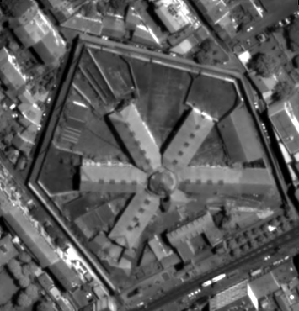

Slide 12
It’s moving vertically, isn’t it ?

Slide 13
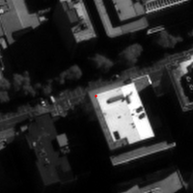
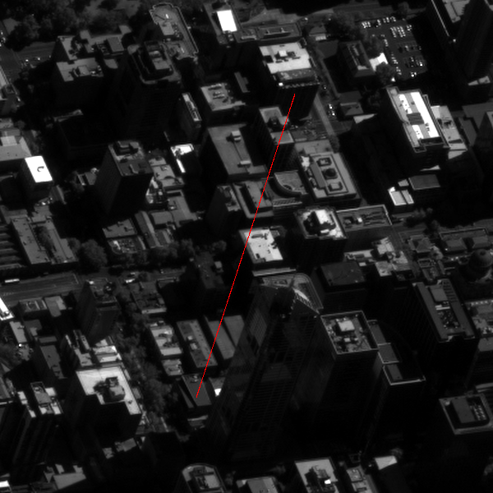

The pointing accuracy problem

Slide 14
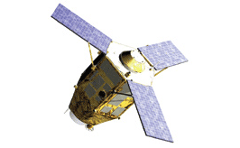
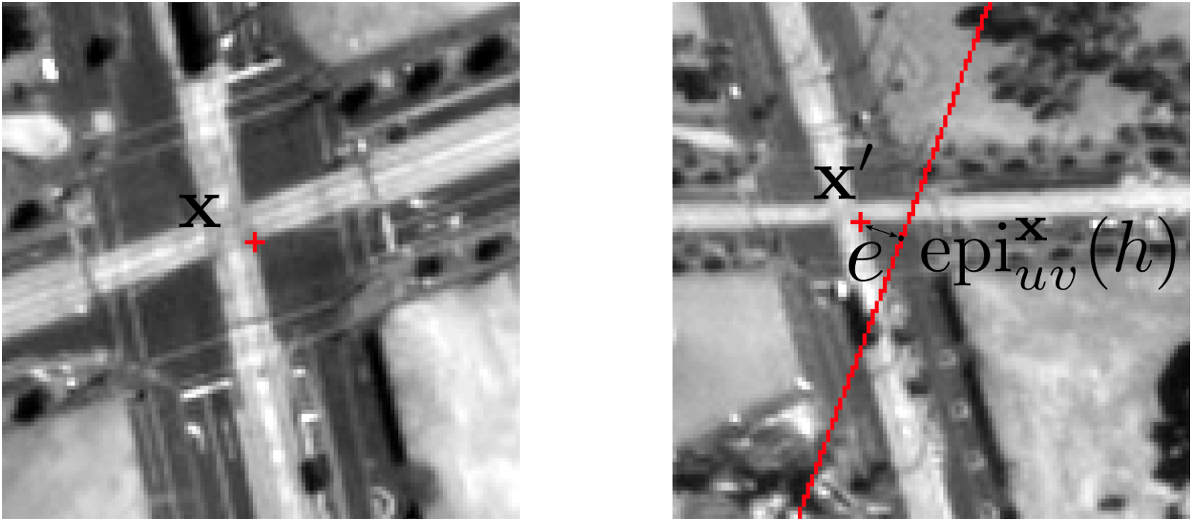
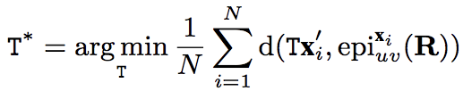
Pointing accuracy refinement

Slide 15
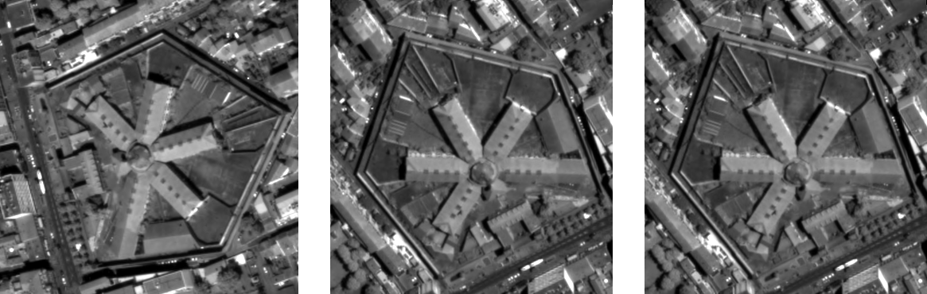
Epipolar rectification
input
rectified with original calibration data
rectified with with pointing accuracy refinement

Slide 16
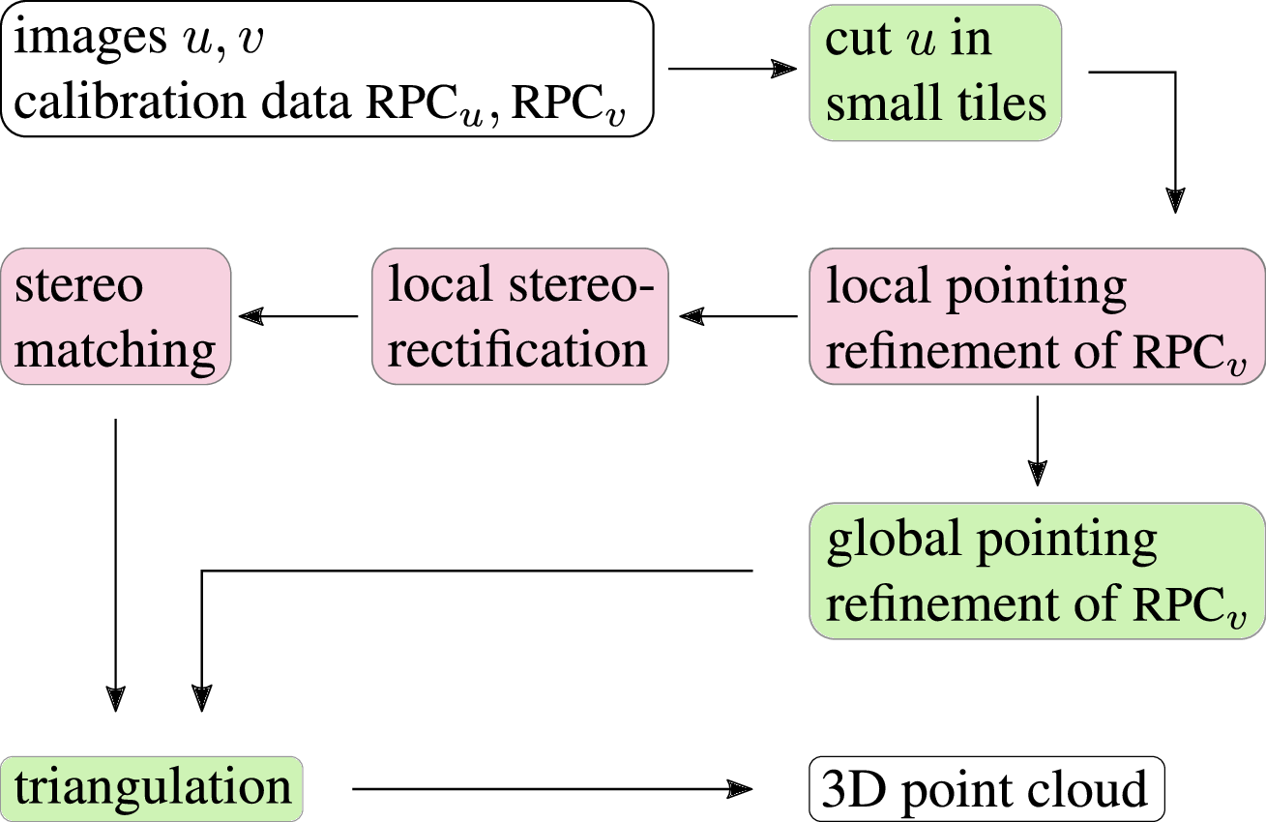
s2p overview

Slide 17
Stereo-matching
more than 150 algorithms listed on Middlebury pages
all of them work with rectified stereo images

Slide 18
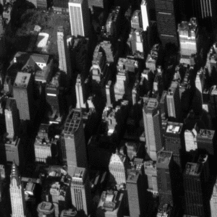
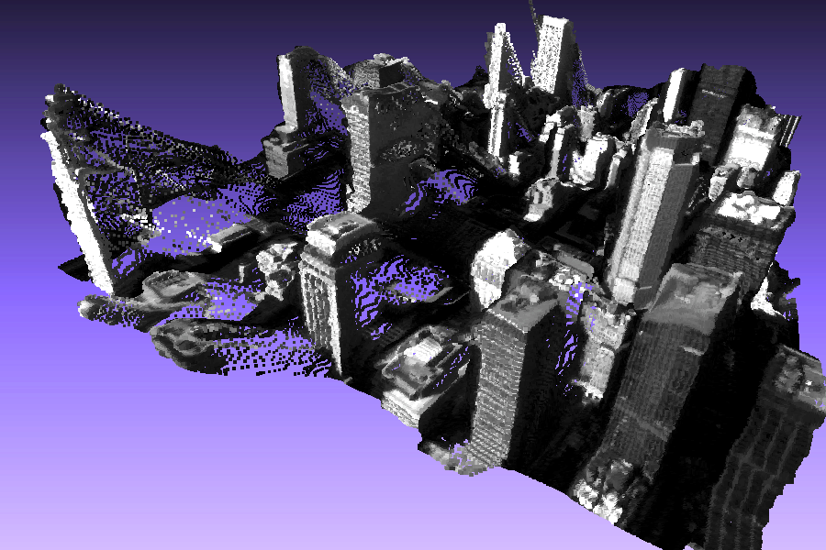
Non-dense stereo matching

Slide 19
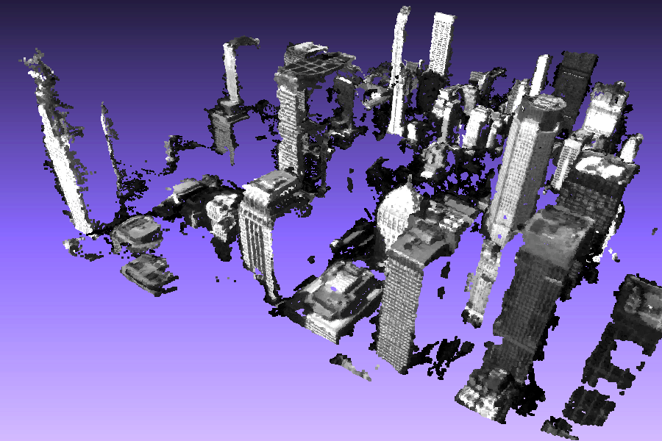
Non-dense stereo matching

Slide 20
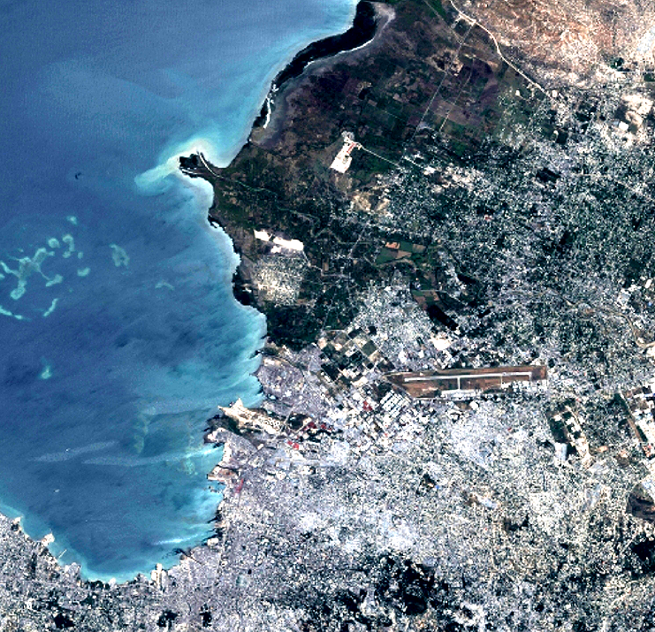


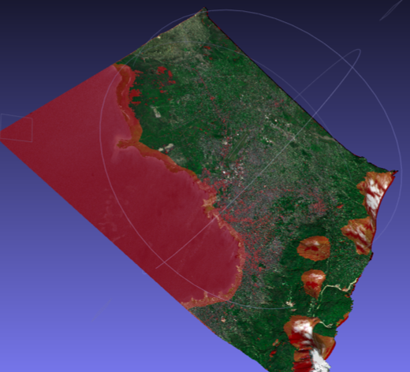
3-view stereo
With the same reference image, compute two point clouds,
then align and merge the clouds

Slide 21
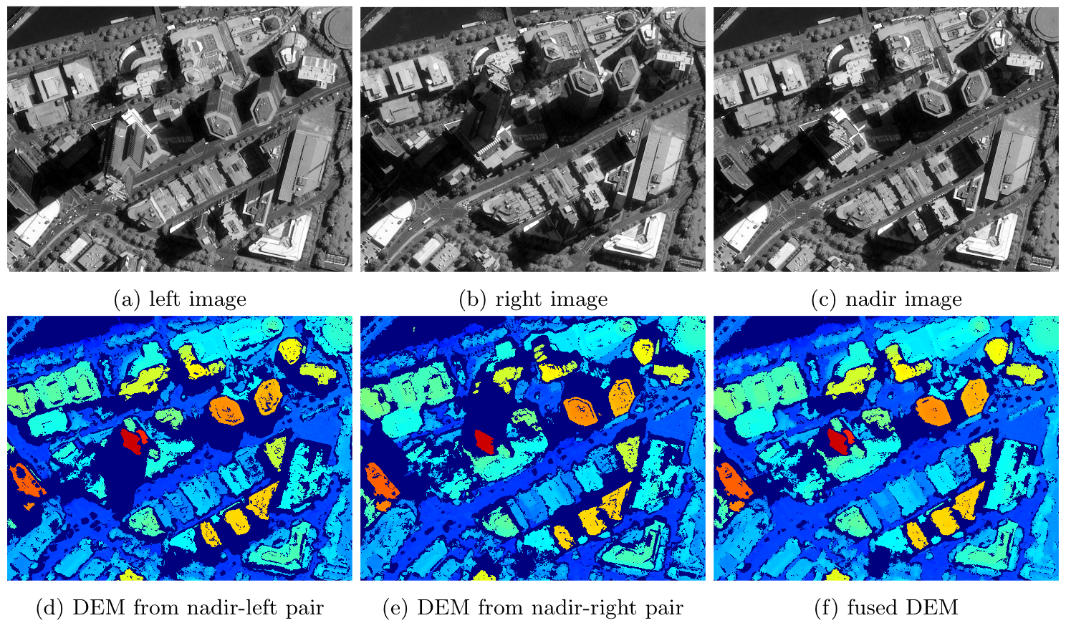

Slide 22
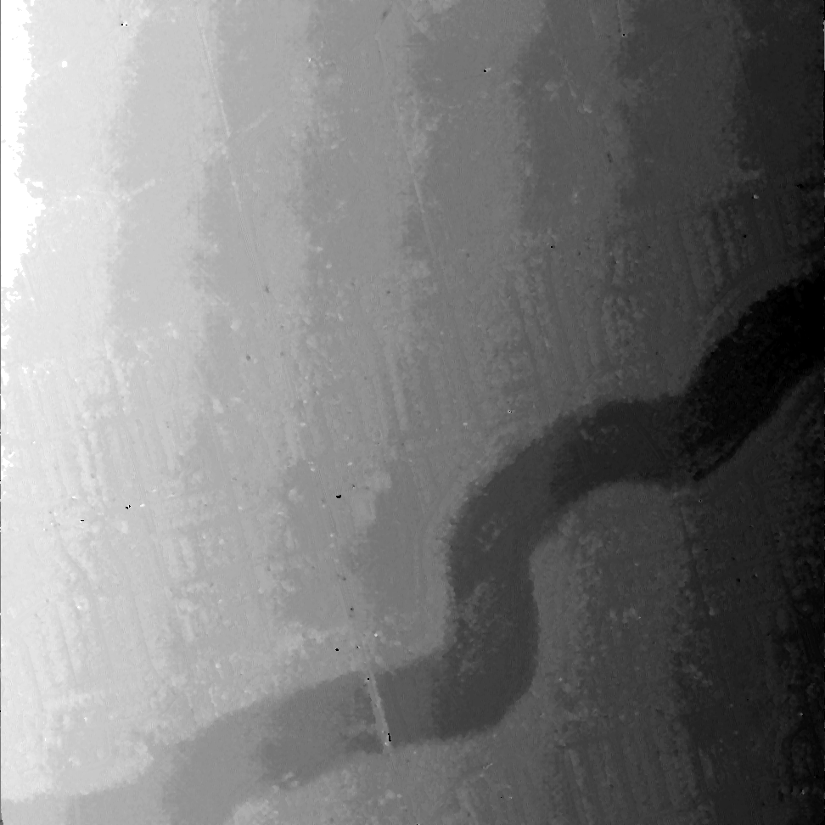
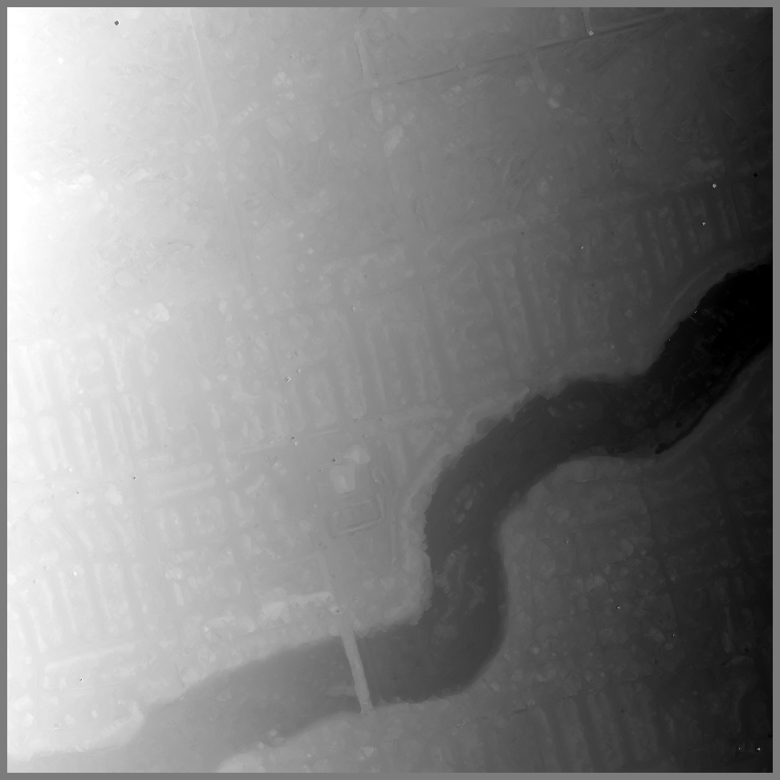
Stereo-matching results (oregon)
SGBM (OpenCV): 9 s
MSMW: 245 s

Slide 23
Results
[interactive show of 3D point clouds in LidarViewer]

Slide 24
Questions ?

Slide 25
Related material
[1] C. de Franchis, E. Meinhardt-Llopis, J. Michel, J.-M. Morel, and G. Facciolo, “An automatic and modular stereo pipeline for pushbroom images”, ISPRS Annals of the Photogrammetry, Remote Sensing and Spatial Information Sciences, 2014
[2] C. de Franchis, E. Meinhardt-Llopis, J. Michel, J.-M. Morel, and G. Facciolo, “Automatic sensor orientation refinement of Pléiades stereo images”, IGARSS 2014.
[3] C. de Franchis, E. Meinhardt-Llopis, J. Michel, J.-M. Morel, and G. Facciolo, “On stereo-rectification of pushbroom images”, ICIP 2014.
[4] C. de Franchis, G. Facciolo, and E. Meinhardt-Llopis, “s2p on-line demo”, http://dev.ipol.im/~carlo/s2p/, 2014.

