Slide 1
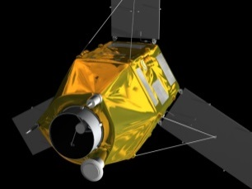
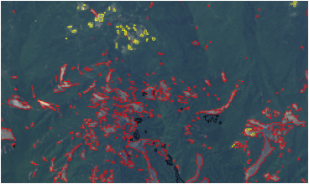
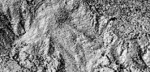
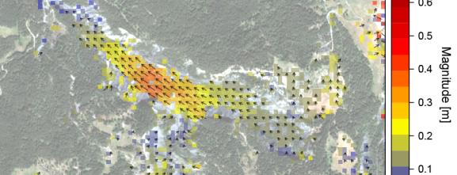






SURFACE RECONSTRUCTIONS FOR LANDSLIDE displacement MONITORING with Pléiades
Seminaire IPGP, 14 Nov
Andre Stumpf (IPGS, LDO-UBO)
JEAN-PHILIPPE MALET (IPGS)
Pascal ALLEMAND (LGLTPE)
PATRICE ULRICH (IPGS)
CHRISTOPHE DELACOURT (LDO-UBO)
ARNAUD DURAND (SERTIT)
ROLAND PERKO (JOHANNEUM RESEARCH)

Slide 2

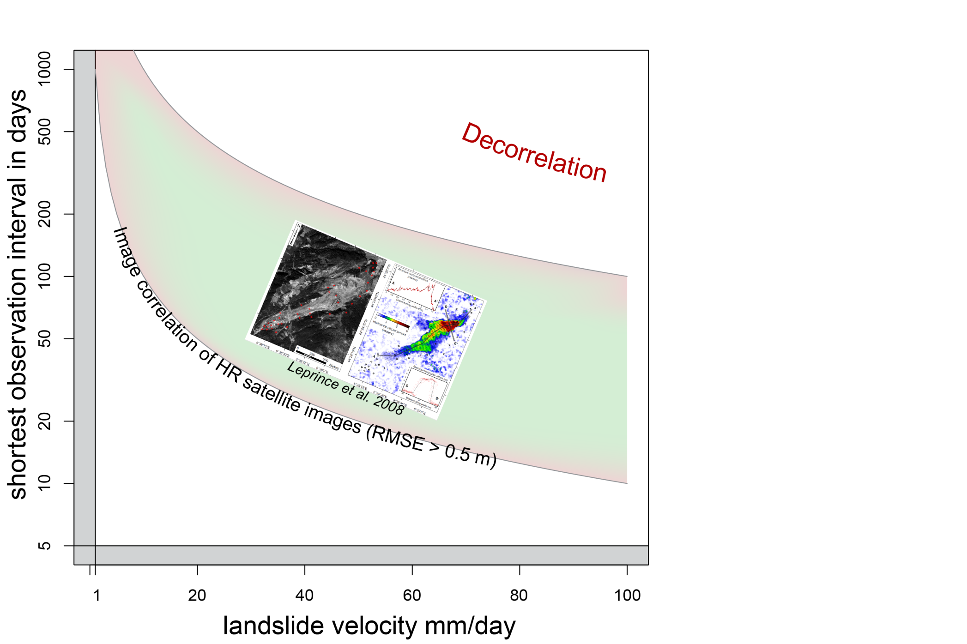
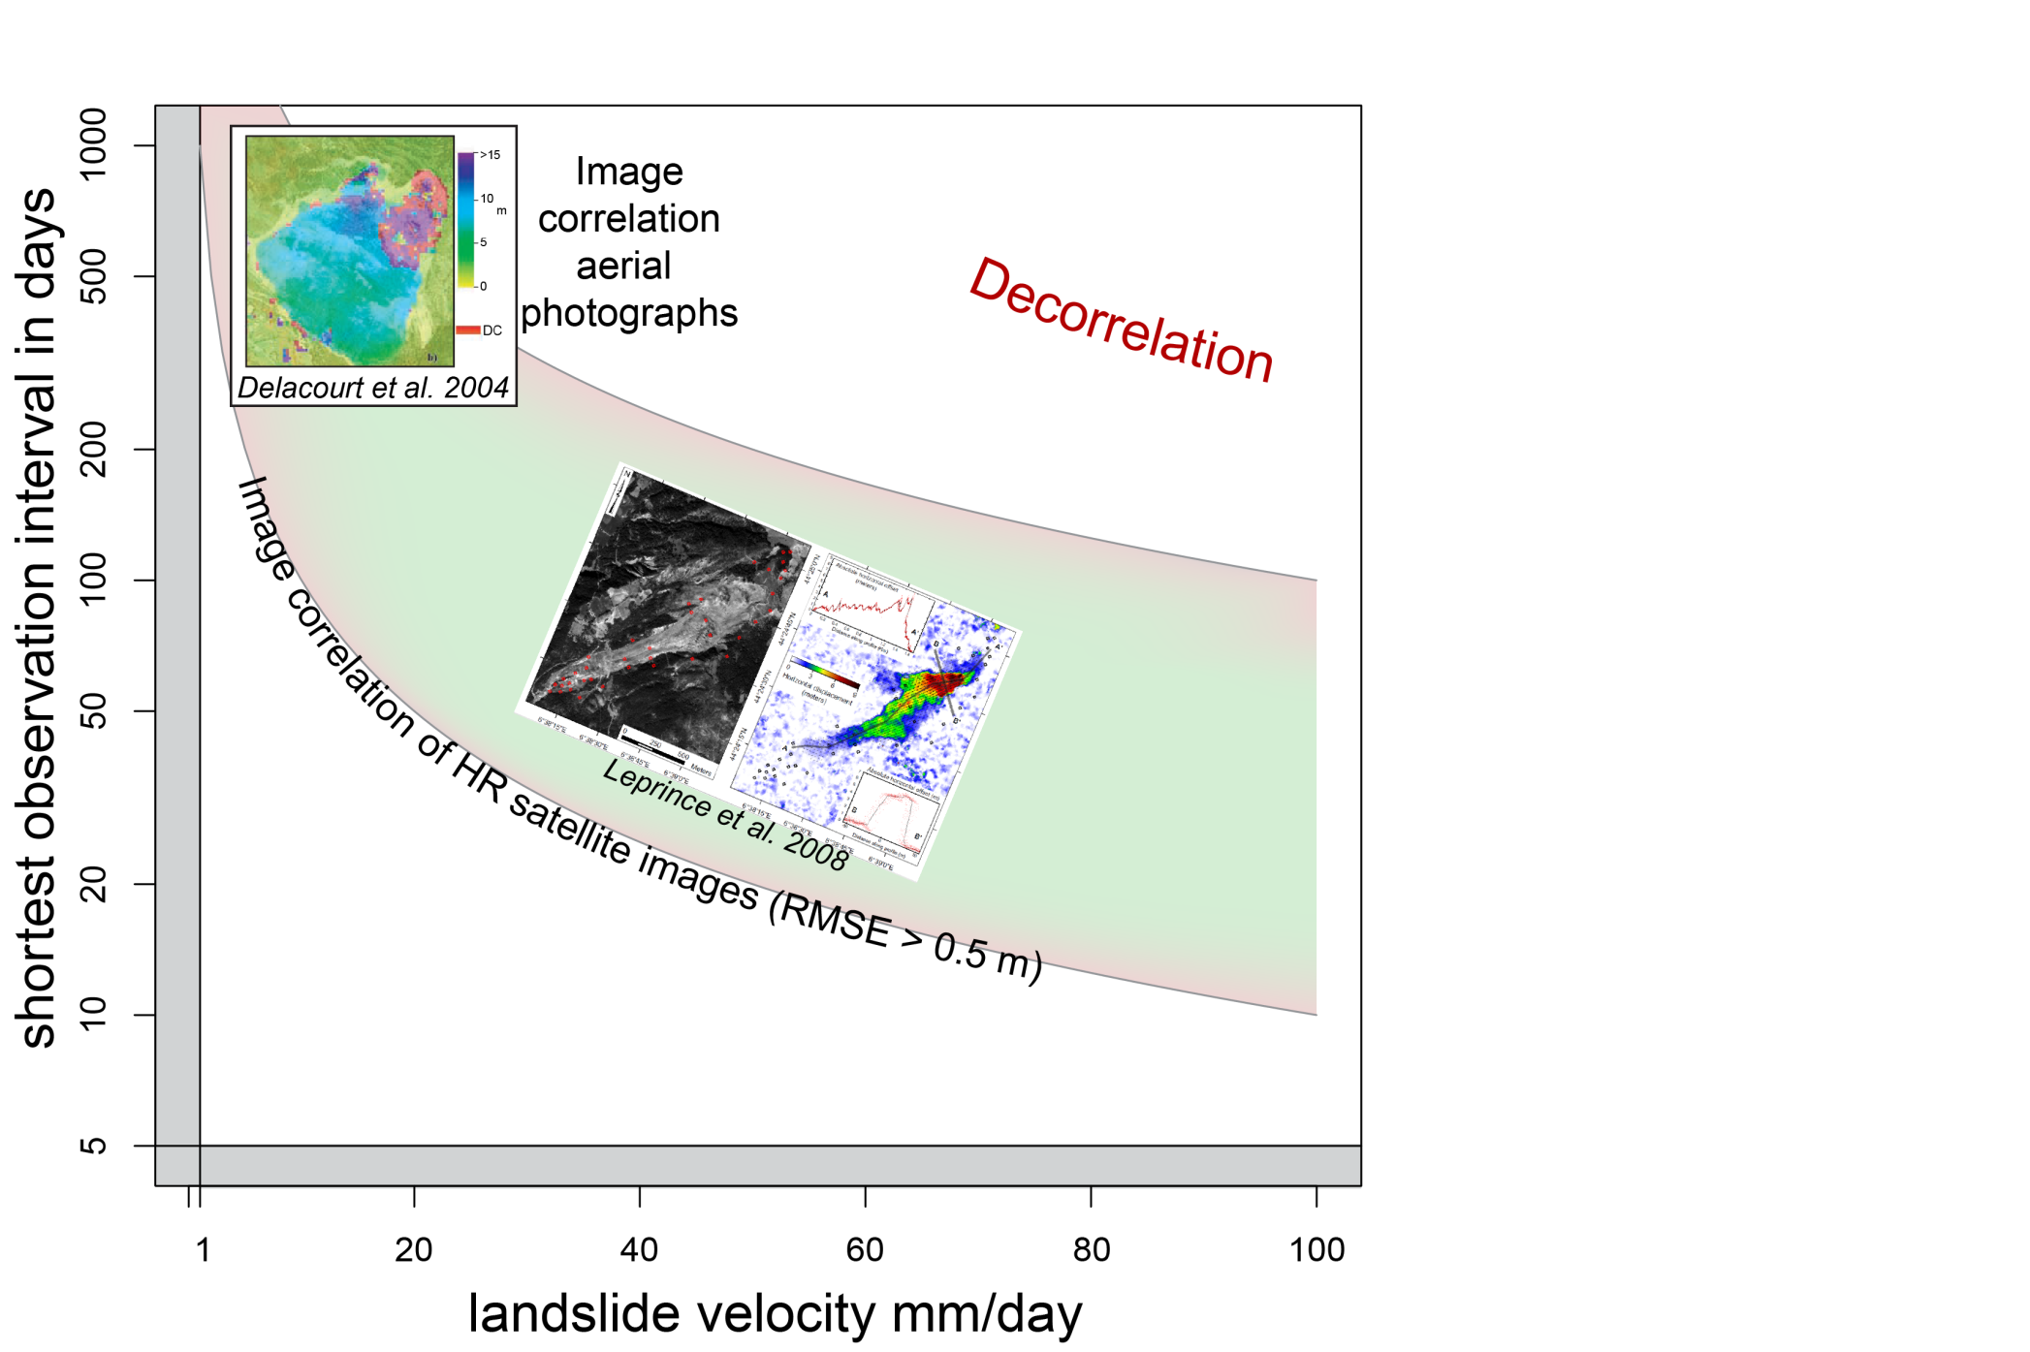
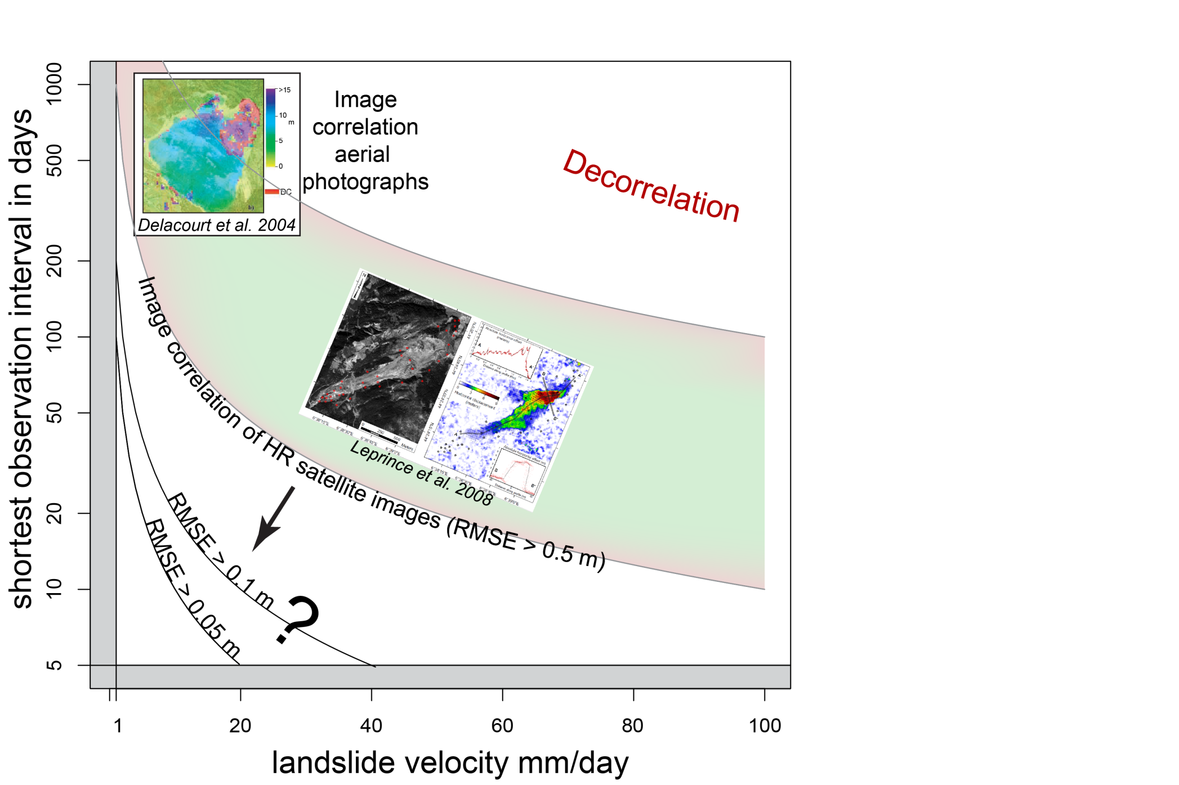
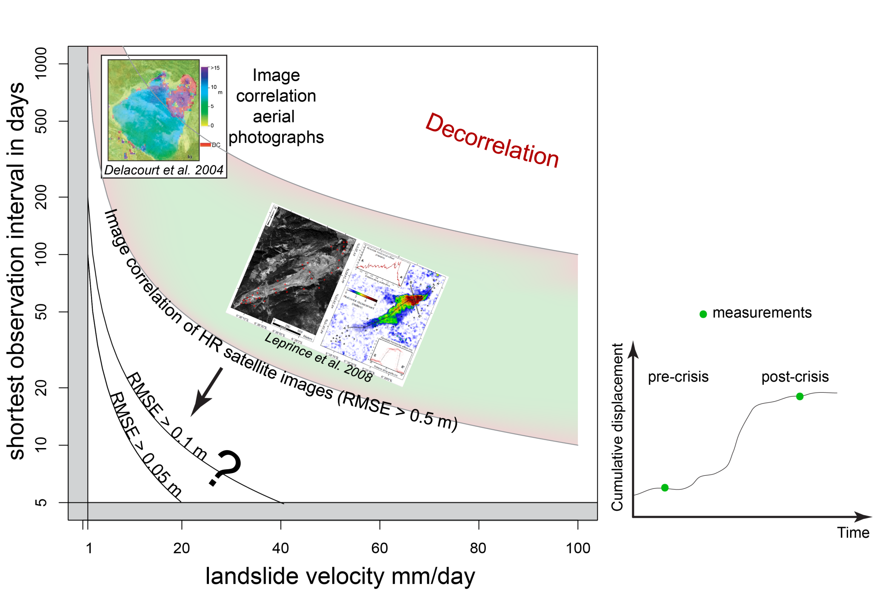


1. MOTIVATION
2. STUDY SITE /DATA
3. PROCESSING
4. RESULTS
5. DISCUSSION/PERSPECTIVES
LANDSLIDE DISPLACEMENT FROM OPTICAL SATELLITE DATA -LIMITATIONS
Which accuracy is possible with VHR satellite images?
Can the processing be automated?
How much ground control?

Slide 3
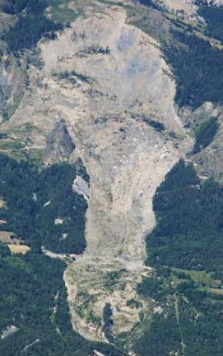
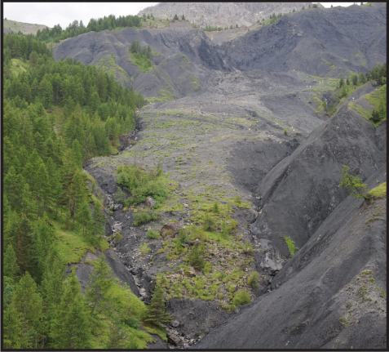
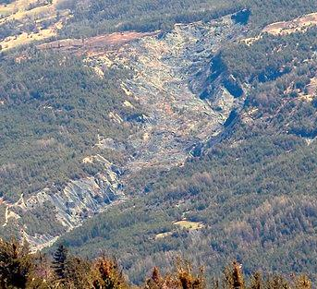
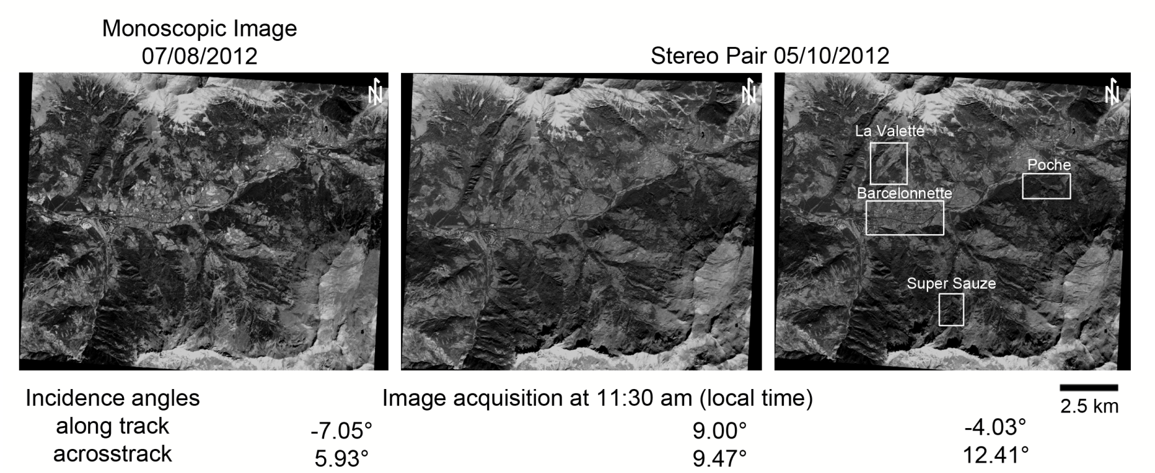
1. MOTIVATION
2. STUDY SITE /DATA
3. PROCESSING
4. RESULTS
5. DISCUSSION/PERSPECTIVES
STUDY SITE AND DATASETS
La Valette Super Sauze Poche
La Valette & Super Sauze
are monitored with permanent GPS (French National Landslide Observatory - OMIV)
Airborne LiDAR scans were available for ground control and accuracy assessment

Slide 4



1. MOTIVATION
2. STUDY SITE /DATA
3. PROCESSING
4. RESULTS
5. DISCUSSION/PERSPECTIVES
TESTED SOFTWARE FOR SURFACE RECONSTRUCTION
ERDAS LPS
(Now Imagine Photogrammetry)
Remote Sensing Graz
(In-house software of Joanneum Research)
MicMac
(Processed by Arnaud Durand/ SERTIT)
~ 350 € / month
Free exchange possible within joint research projects
Open Source !!!

Slide 5
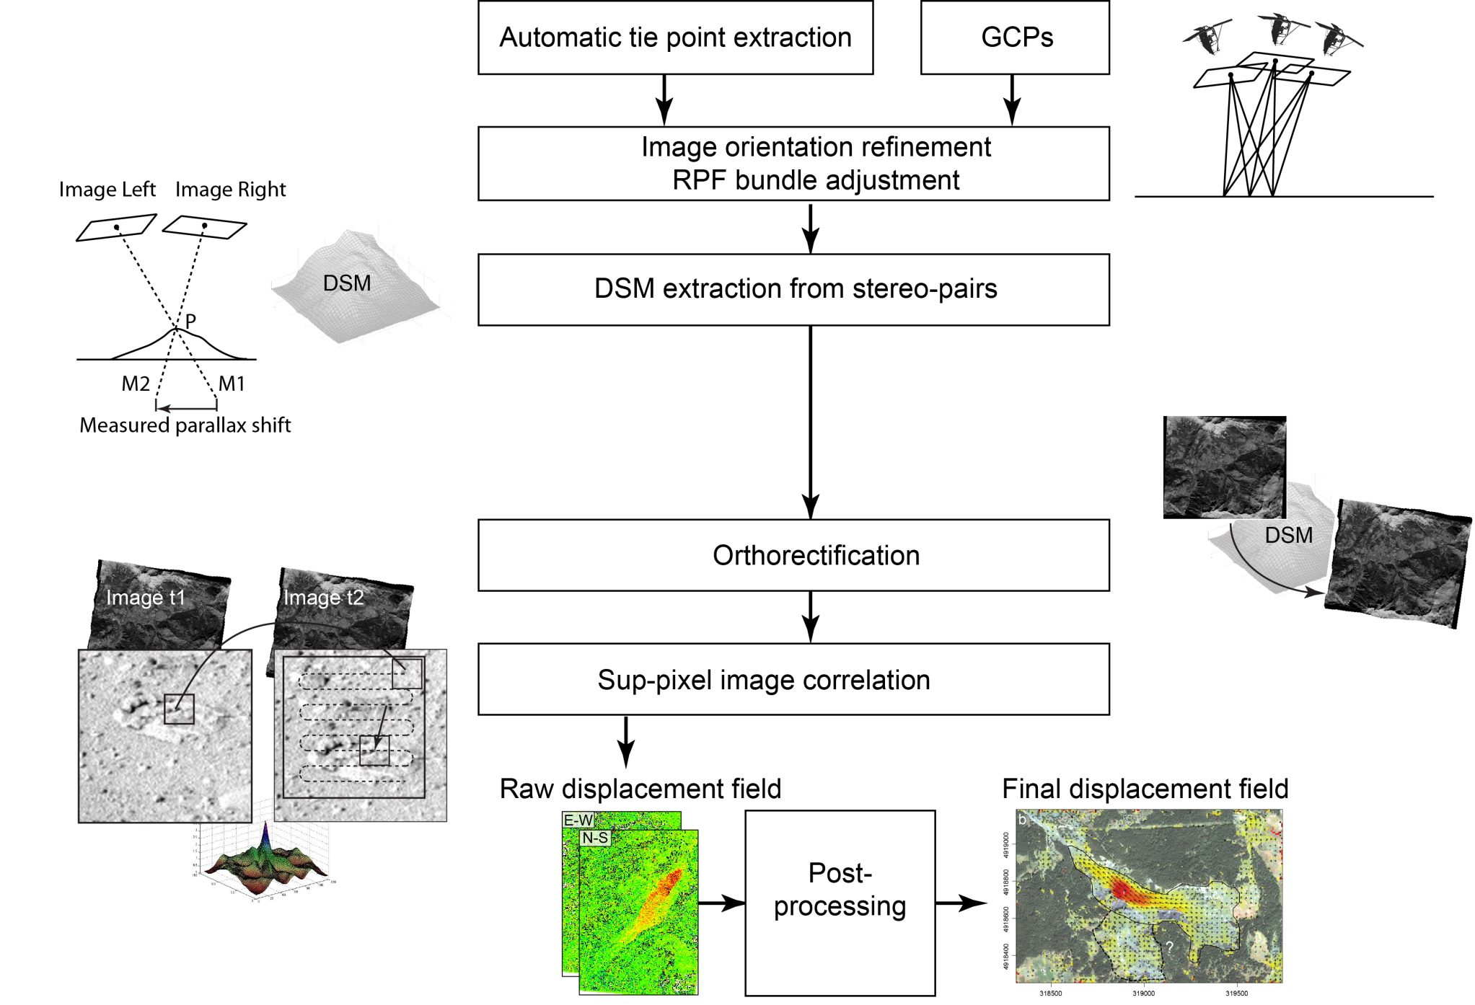
1. MOTIVATION
2. STUDY SITE /DATA
3. PROCESSING
4. RESULTS
5. DISCUSSION/PERSPECTIVES
PROCESSING CHAIN – ERDAS LPS / RSG
Overview

Slide 6
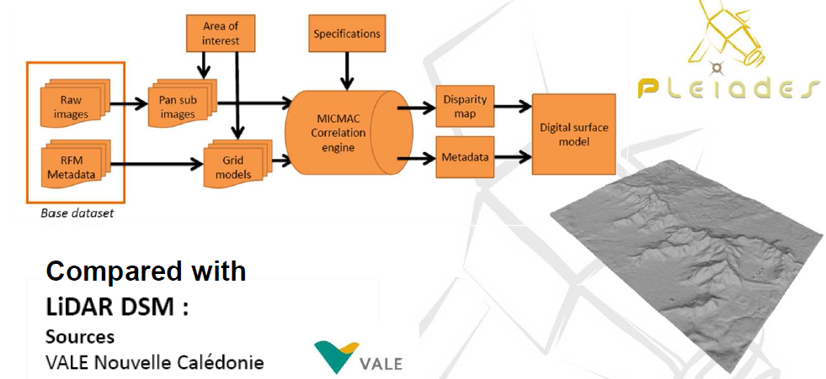
1. MOTIVATION
2. STUDY SITE /DATA
3. PROCESSING
4. RESULTS
5. DISCUSSION/PERSPECTIVES
PROCESSING CHAIN – MICMAC
Matching only, no refinement of the sensor model
Arnaud Durand/ SERTIT

Slide 7
1. MOTIVATION
2. STUDY SITE /DATA
3. PROCESSING
4. RESULTS
5. DISCUSSION/PERSPECTIVES
PROCESSING CHAIN – ERDAS LPS
55 well-distributed GCPs were derived from aerial LiDAR scans
Bundle-adjustment, DSM reconstruction and orthorectification with Erdas LPS
4 images (3 PAN + 1 MS) were processed in one block file
126 tie points were initially extracted and points with residuals >0.5 pixel were removed (~ 18% )
Bundle adjustment was tested with 0 / 5 / 40 GCPs and different models for bias correction (shift / affine), GCPs uncertainty was estimated at 0.21 m
Window size for stereo-matching = 7 pixel
Minimum correlation coefficient = 0.8
Gridded surface was generated (0.5 m pixel size) using Natural Neighbor interpolation
Orthorectification (0.5 m pixel size) with bicubic interpolation
Sub-pixel correlation in CosiCorr (Leprince et al. 2007) with a hierarchical scheme (window size iteratively decreasing 64 / 32 / 16 pixel), correlation threshold = 0.8
Notes:
The elaborated processing chain looks like this.
The first step is to refine the image-to-image and image-to-ground orientation from tie points and ground control points
Once the orienations are correct stereo-photogrammetry can be employed to generate a digitial surface model
Which in turn can be used to correct the topographic distorsion within the images – a process commonly known as orthorectification
And sub-pixel image correlaion was then applied on the orthorectified images to obtain raw displacement fields
And a post-processing routing is applied to reduce noise and false matches
We gave particular attention to four points beeing the accuracy of the image orientation, the accuracy of the DSM , of cause the accuracy of the resulting dispalcement fields but also the influence of the number of ground control points.
So we carried out several experiments with different numbers of Ground control points

Slide 8
1. MOTIVATION
2. STUDY SITE /DATA
3. PROCESSING
4. RESULTS
5. DISCUSSION/PERSPECTIVES
BUNDLE ADJUSTMENT – ERDAS LPS
All solutions yield very small residuals in image space (less than 1/3 pixel)
Biased ground coordinates when no GCPs are used (surprisingly high!)
Affine models seem to yield slightly lower residuals
Improvements of geolocation accuracy with > 5 GCPs are very small
 | No GCPs | 5 GCPs shift | 5 GCPs affine | 40 GCPs shift | 40 GCPs affine
 | Check point RMSE | Check point RMSE | Check point RMSE | Check point RMSE | Check point RMSE
Ground X [m] | 3.80 | 0.46 | 0.46 | 0.44 | 0.41
Ground Y [m] | 12.08 | 0.58 | 0.29 | 0.60 | 0.27
Ground Z [m] | 34.19 | 0.60 | 0.62 | 0.50 | 0.50
Total Image [pxl.] | 0.27 | 0.21 | 0.16 | 0.32 | 0.23
Notes:
The elaborated processing chain looks like this.
The first step is to refine the image-to-image and image-to-ground orientation from tie points and ground control points
Once the orienations are correct stereo-photogrammetry can be employed to generate a digitial surface model
Which in turn can be used to correct the topographic distorsion within the images – a process commonly known as orthorectification
And sub-pixel image correlaion was then applied on the orthorectified images to obtain raw displacement fields
And a post-processing routing is applied to reduce noise and false matches
We gave particular attention to four points beeing the accuracy of the image orientation, the accuracy of the DSM , of cause the accuracy of the resulting dispalcement fields but also the influence of the number of ground control points.
So we carried out several experiments with different numbers of Ground control points

Slide 9
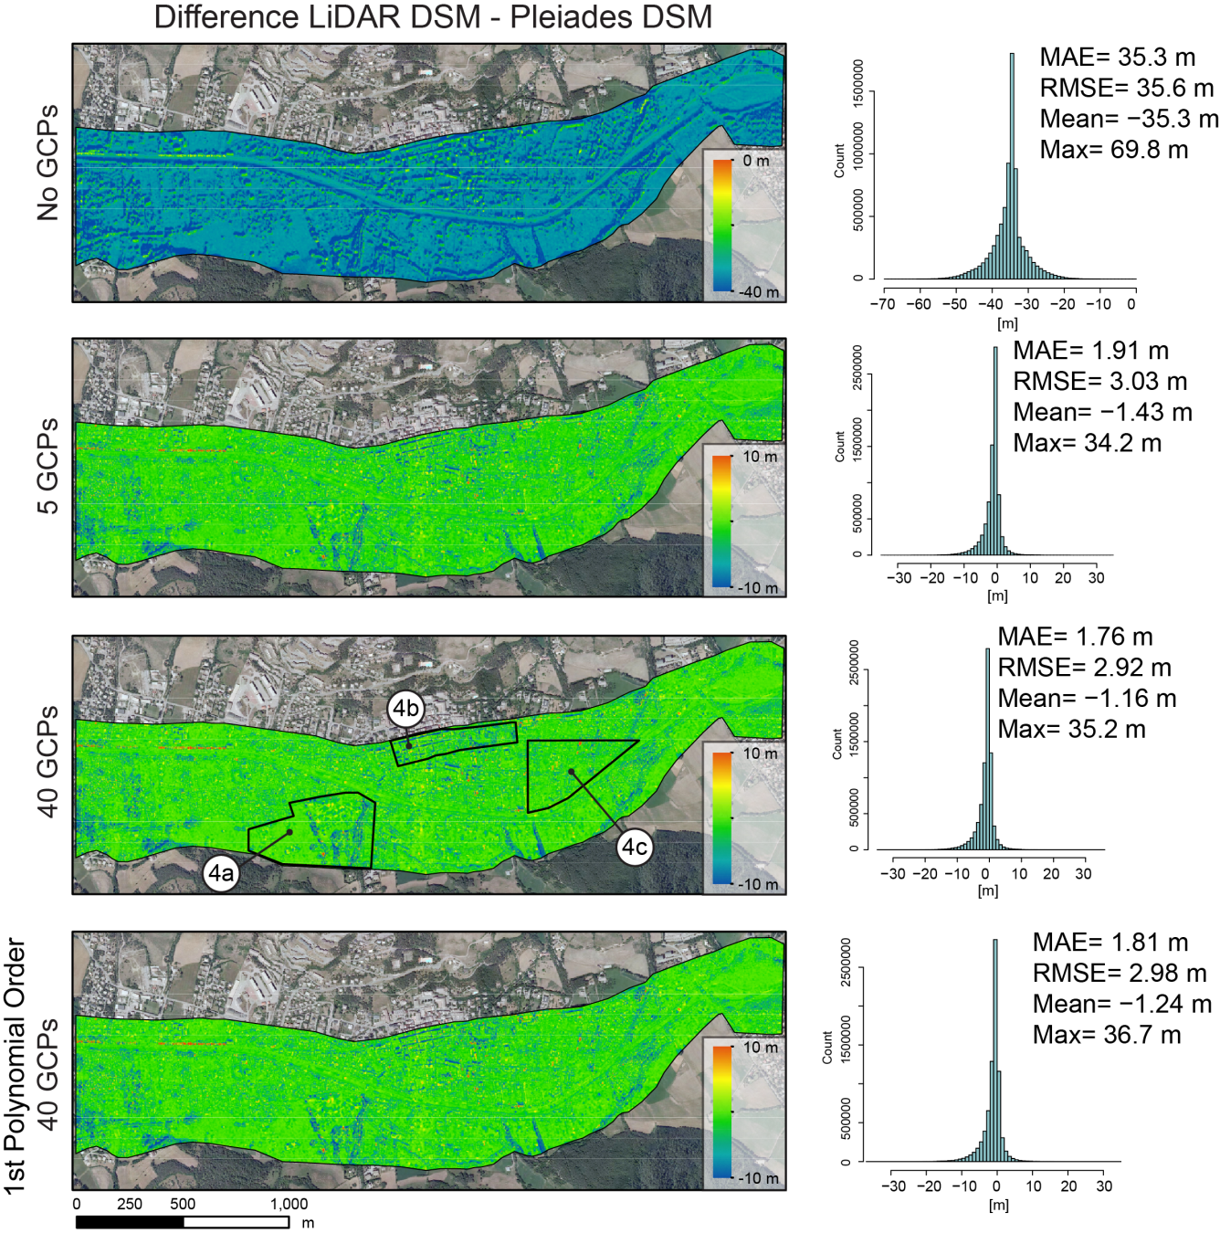
1. MOTIVATION
2. STUDY SITE /DATA
3. PROCESSING
4. RESULTS
5. DISCUSSION/PERSPECTIVES
DSM – ERDAS LPS vs. LiDAR
Strong bias (MAE = 35.3 m) when using no ground control resulting from global offset
Rather small enhancements with > 5 GCPs
Strongly inhomogenous distribution of the errors according to different surface characteristics
Notes:
The elaborated processing chain looks like this.
The first step is to refine the image-to-image and image-to-ground orientation from tie points and ground control points
Once the orienations are correct stereo-photogrammetry can be employed to generate a digitial surface model
Which in turn can be used to correct the topographic distorsion within the images – a process commonly known as orthorectification
And sub-pixel image correlaion was then applied on the orthorectified images to obtain raw displacement fields
And a post-processing routing is applied to reduce noise and false matches
We gave particular attention to four points beeing the accuracy of the image orientation, the accuracy of the DSM , of cause the accuracy of the resulting dispalcement fields but also the influence of the number of ground control points.
So we carried out several experiments with different numbers of Ground control points

Slide 10
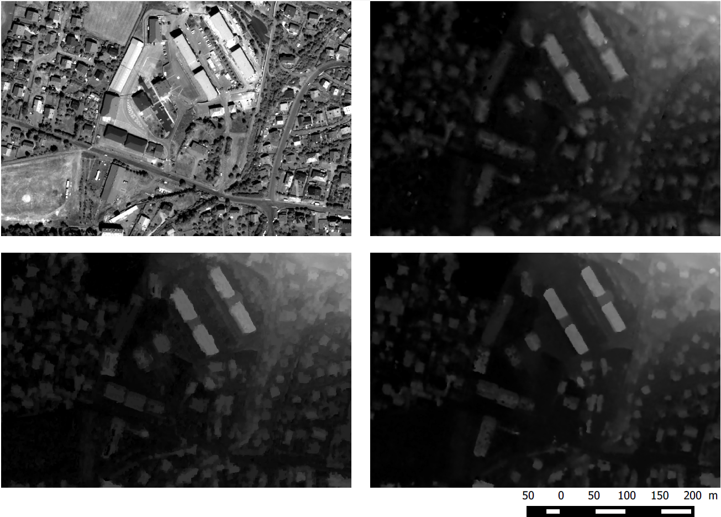
1. MOTIVATION
2. STUDY SITE /DATA
3. PROCESSING
4. RESULTS
5. DISCUSSION/PERSPECTIVES
RESULTS – VISUAL COMPARISON (SEOLANE CENTER)
Orthorectified Pléiades Images
DSM Erdas LPS
DSM MICMAC
DSM RSG
Notes:
The elaborated processing chain looks like this.
The first step is to refine the image-to-image and image-to-ground orientation from tie points and ground control points
Once the orienations are correct stereo-photogrammetry can be employed to generate a digitial surface model
Which in turn can be used to correct the topographic distorsion within the images – a process commonly known as orthorectification
And sub-pixel image correlaion was then applied on the orthorectified images to obtain raw displacement fields
And a post-processing routing is applied to reduce noise and false matches
We gave particular attention to four points beeing the accuracy of the image orientation, the accuracy of the DSM , of cause the accuracy of the resulting dispalcement fields but also the influence of the number of ground control points.
So we carried out several experiments with different numbers of Ground control points

Slide 11
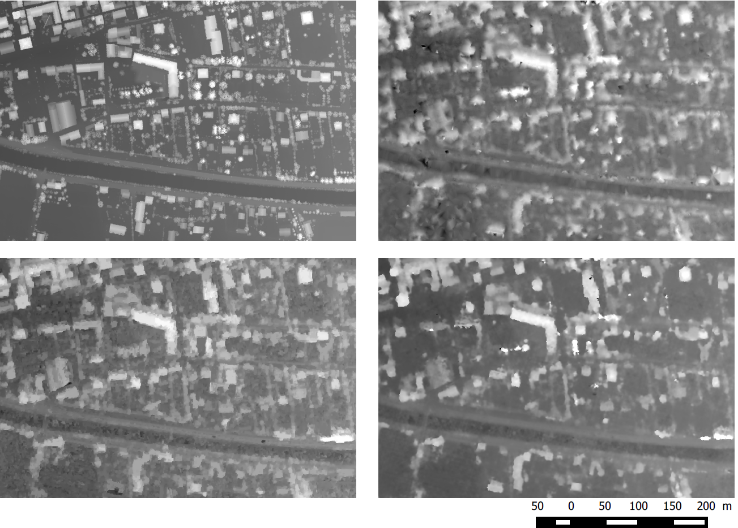
1. MOTIVATION
2. STUDY SITE /DATA
3. PROCESSING
4. RESULTS
5. DISCUSSION/PERSPECTIVES
RESULTS – VISUAL COMPARISON (BARCELONNETTE TOWN CENTER)
DSM LiDAR
DSM Erdas LPS
DSM MICMAC
DSM RSG
Notes:
The elaborated processing chain looks like this.
The first step is to refine the image-to-image and image-to-ground orientation from tie points and ground control points
Once the orienations are correct stereo-photogrammetry can be employed to generate a digitial surface model
Which in turn can be used to correct the topographic distorsion within the images – a process commonly known as orthorectification
And sub-pixel image correlaion was then applied on the orthorectified images to obtain raw displacement fields
And a post-processing routing is applied to reduce noise and false matches
We gave particular attention to four points beeing the accuracy of the image orientation, the accuracy of the DSM , of cause the accuracy of the resulting dispalcement fields but also the influence of the number of ground control points.
So we carried out several experiments with different numbers of Ground control points

Slide 12
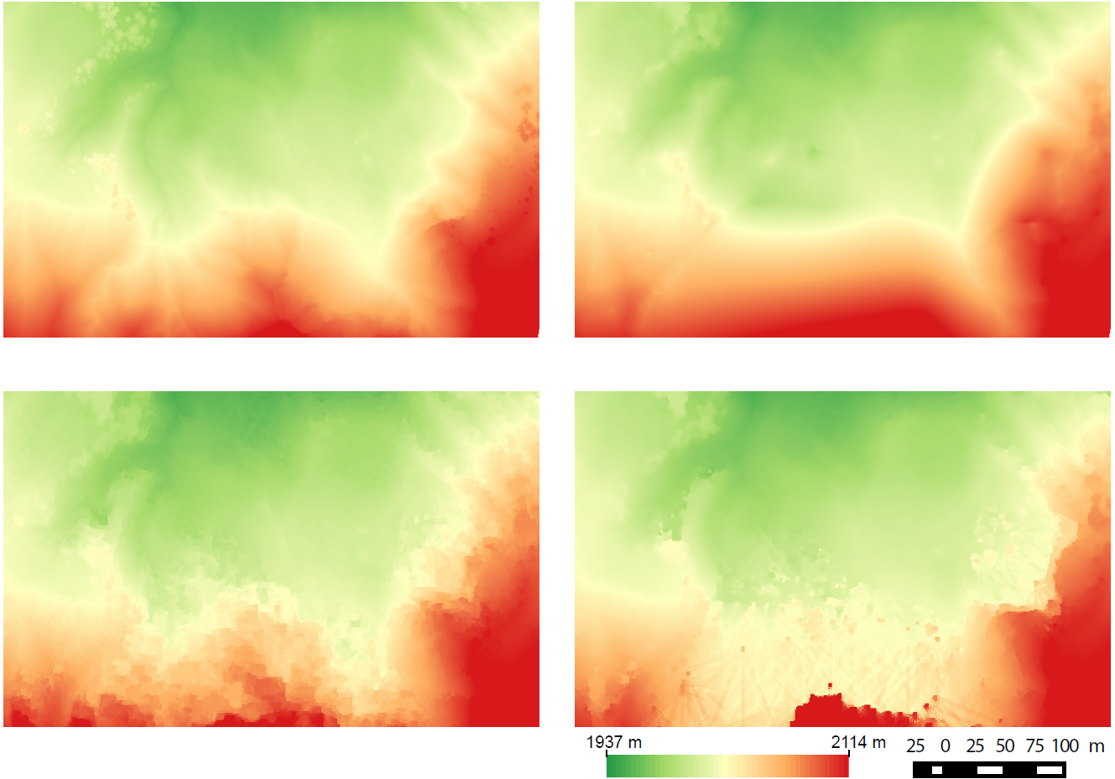
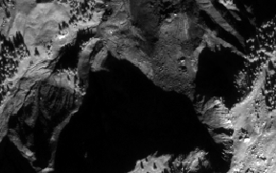
1. MOTIVATION
2. STUDY SITE /DATA
3. PROCESSING
4. RESULTS
5. DISCUSSION/PERSPECTIVES
RESULTS – VISUAL COMPARISON (SUPER SAUZE LANDSLIDE/ MAIN SCARP)
DSM LiDAR
DSM Erdas LPS
DSM MICMAC
DSM RSG
Notes:
The elaborated processing chain looks like this.
The first step is to refine the image-to-image and image-to-ground orientation from tie points and ground control points
Once the orienations are correct stereo-photogrammetry can be employed to generate a digitial surface model
Which in turn can be used to correct the topographic distorsion within the images – a process commonly known as orthorectification
And sub-pixel image correlaion was then applied on the orthorectified images to obtain raw displacement fields
And a post-processing routing is applied to reduce noise and false matches
We gave particular attention to four points beeing the accuracy of the image orientation, the accuracy of the DSM , of cause the accuracy of the resulting dispalcement fields but also the influence of the number of ground control points.
So we carried out several experiments with different numbers of Ground control points

Slide 13
1. MOTIVATION
2. STUDY SITE /DATA
3. PROCESSING
4. RESULTS
5. DISCUSSION/PERSPECTIVES
RESULTS – VISUAL COMPARISON (SUPER SAUZE LANDSLIDE/ MAIN SCARP)
DSM LiDAR
DSM Erdas LPS
DSM MICMAC
DSM RSG
Notes:
The elaborated processing chain looks like this.
The first step is to refine the image-to-image and image-to-ground orientation from tie points and ground control points
Once the orienations are correct stereo-photogrammetry can be employed to generate a digitial surface model
Which in turn can be used to correct the topographic distorsion within the images – a process commonly known as orthorectification
And sub-pixel image correlaion was then applied on the orthorectified images to obtain raw displacement fields
And a post-processing routing is applied to reduce noise and false matches
We gave particular attention to four points beeing the accuracy of the image orientation, the accuracy of the DSM , of cause the accuracy of the resulting dispalcement fields but also the influence of the number of ground control points.
So we carried out several experiments with different numbers of Ground control points

Slide 14
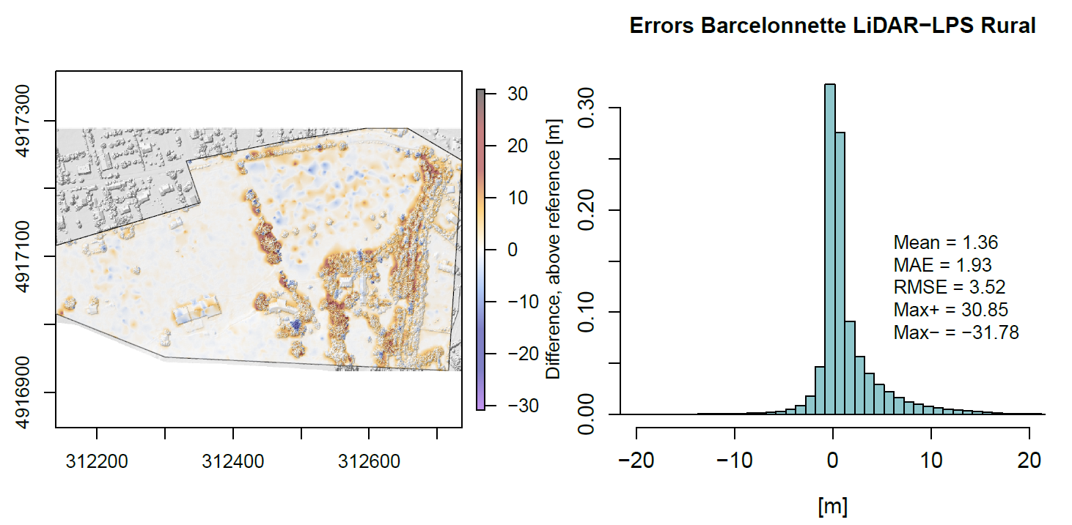
1. MOTIVATION
2. STUDY SITE /DATA
3. PROCESSING
4. RESULTS
5. DISCUSSION/PERSPECTIVES
RESULTS – QUANTITATIVE COMPARISON (BARCELONNETTE)

Slide 15
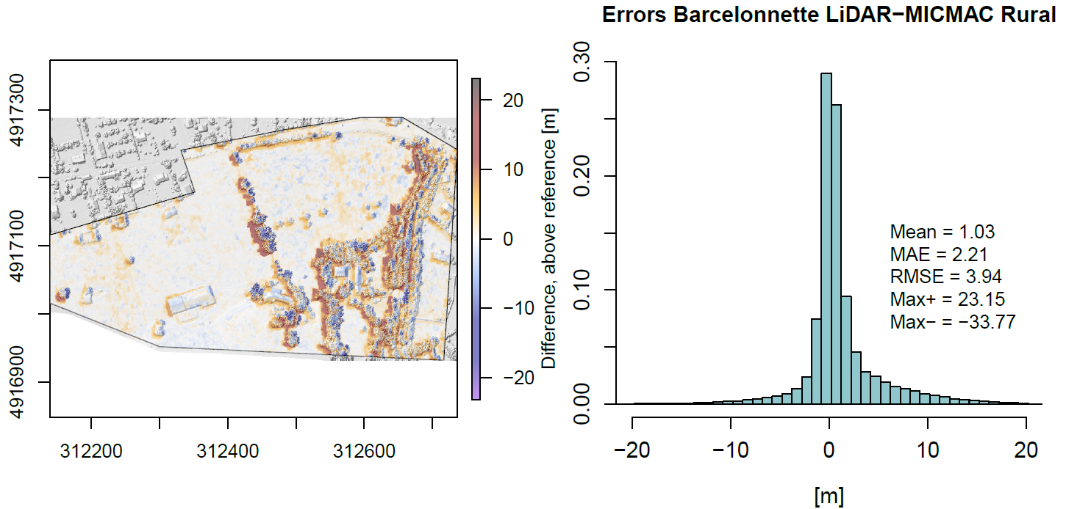
1. MOTIVATION
2. STUDY SITE /DATA
3. PROCESSING
4. RESULTS
5. DISCUSSION/PERSPECTIVES
RESULTS – QUANTITATIVE COMPARISON (BARCELONNETTE)
Since no triangulation is performed the bias of the original sensor model remains
  ► Surface reconstruction is actually better but the offset yields higher overall error

Slide 16
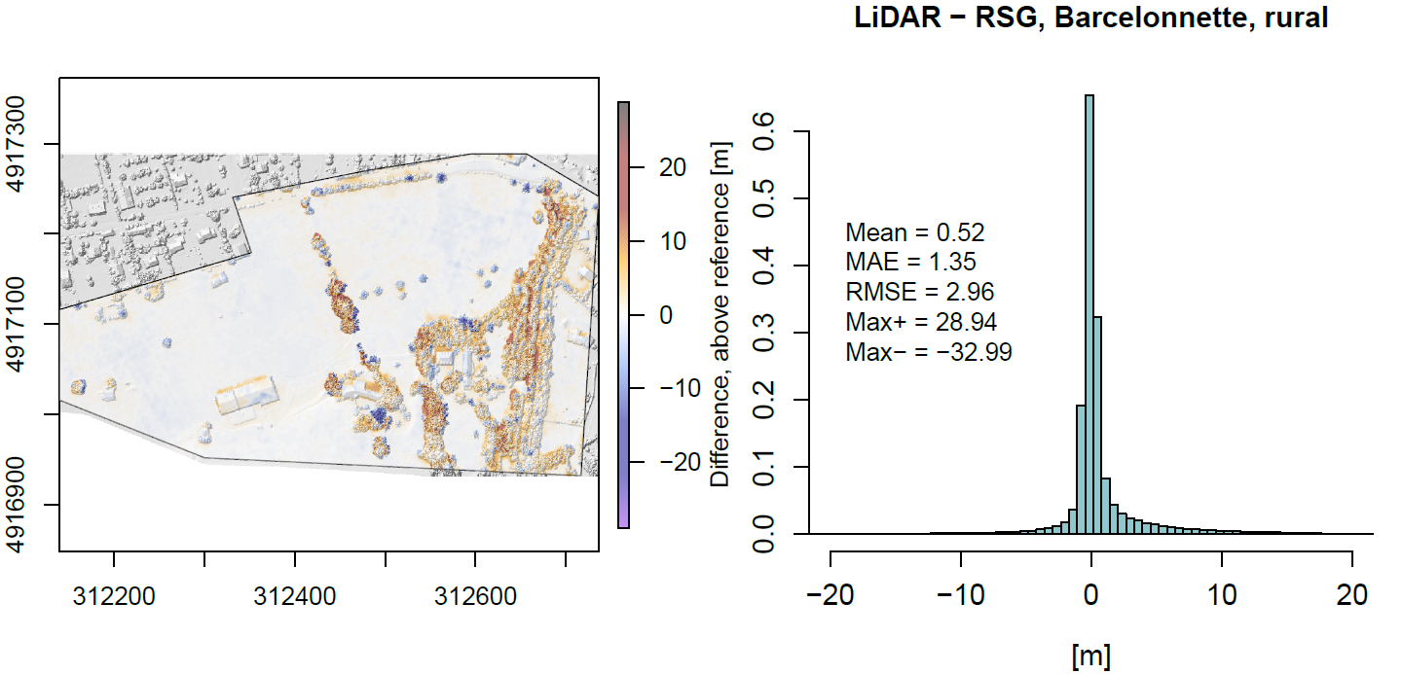
1. MOTIVATION
2. STUDY SITE /DATA
3. PROCESSING
4. RESULTS
5. DISCUSSION/PERSPECTIVES
RESULTS – QUANTITATIVE COMPARISON (BARCELONNETTE)

Slide 17
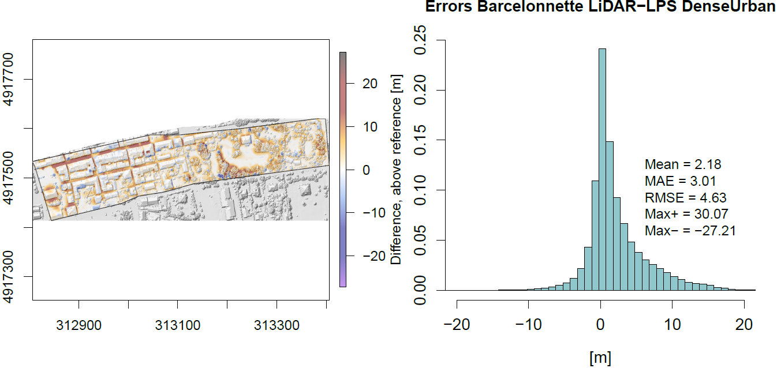
1. MOTIVATION
2. STUDY SITE /DATA
3. PROCESSING
4. RESULTS
5. DISCUSSION/PERSPECTIVES
RESULTS – QUANTITATIVE COMPARISON (BARCELONNETTE)

Slide 18
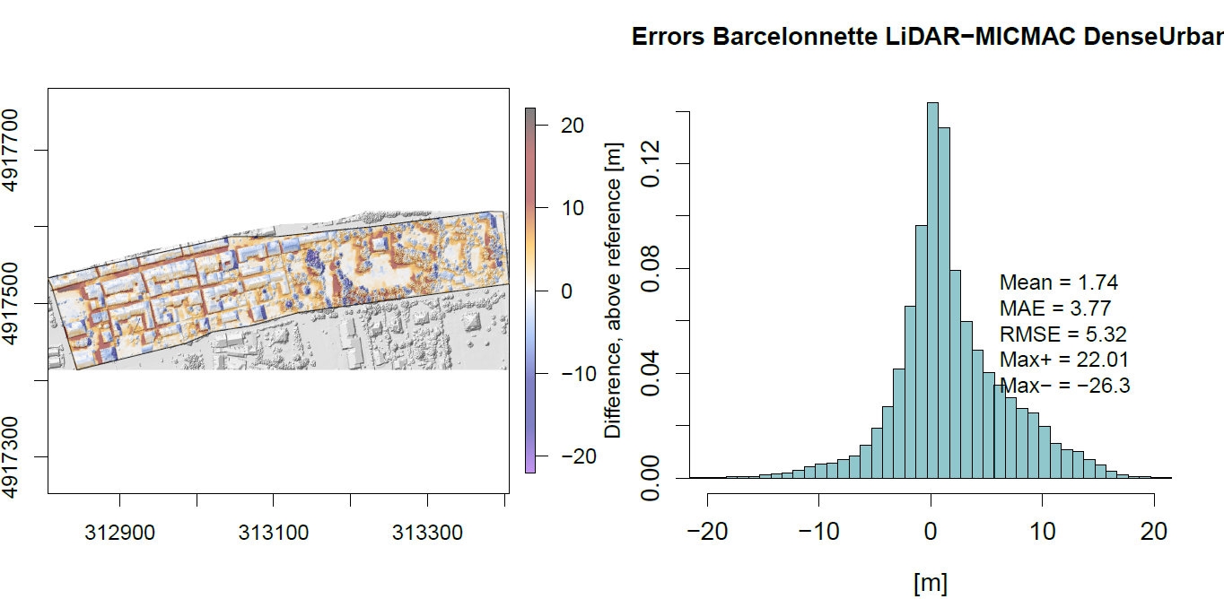
1. MOTIVATION
2. STUDY SITE /DATA
3. PROCESSING
4. RESULTS
5. DISCUSSION/PERSPECTIVES
RESULTS – QUANTITATIVE COMPARISON (BARCELONNETTE)
As said before…
  ► Surface reconstruction with MicMac is actually better but offset yields higher overall error

Slide 19
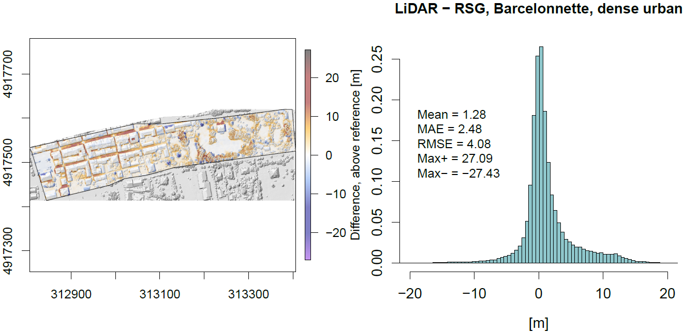
1. MOTIVATION
2. STUDY SITE /DATA
3. PROCESSING
4. RESULTS
5. DISCUSSION/PERSPECTIVES
RESULTS – QUANTITATIVE COMPARISON (BARCELONNETTE)
  ► RSG seem to provide an advantage for urban areas

Slide 20
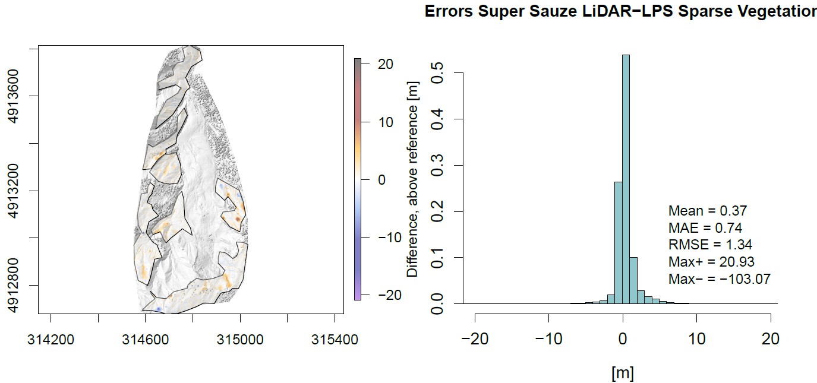
1. MOTIVATION
2. STUDY SITE /DATA
3. PROCESSING
4. RESULTS
5. DISCUSSION/PERSPECTIVES
RESULTS – QUANTITATIVE COMPARISON (SUPER SAUZE LANDSLIDE)
  ► Higher errors for forested and very steep areas
  ► LPS is the most accurate for such zones

Slide 21
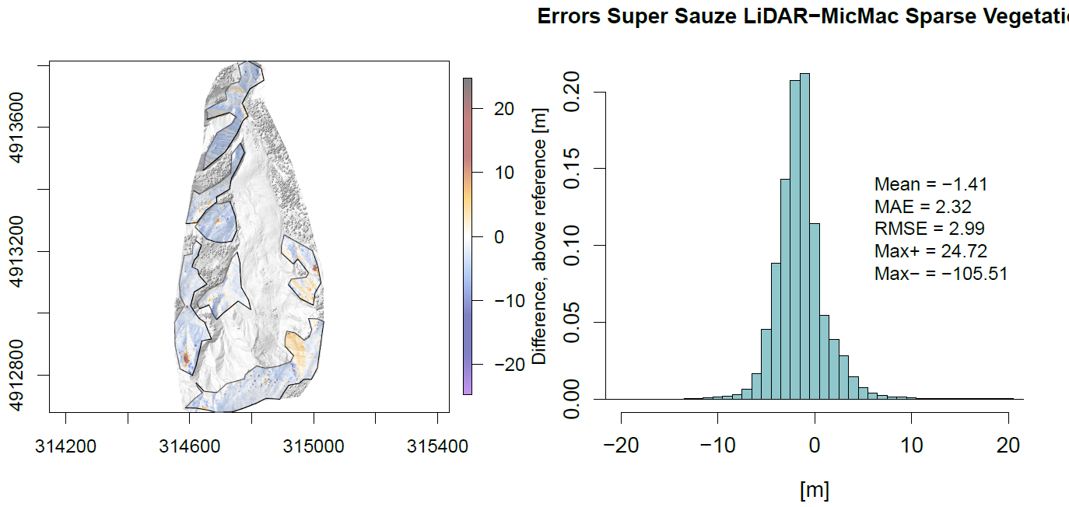
1. MOTIVATION
2. STUDY SITE /DATA
3. PROCESSING
4. RESULTS
5. DISCUSSION/PERSPECTIVES
RESULTS – QUANTITATIVE COMPARISON (SUPER SAUZE LANDSLIDE)
  ► Again, MicMac might be more accurate but the bias eats up the gains

Slide 22
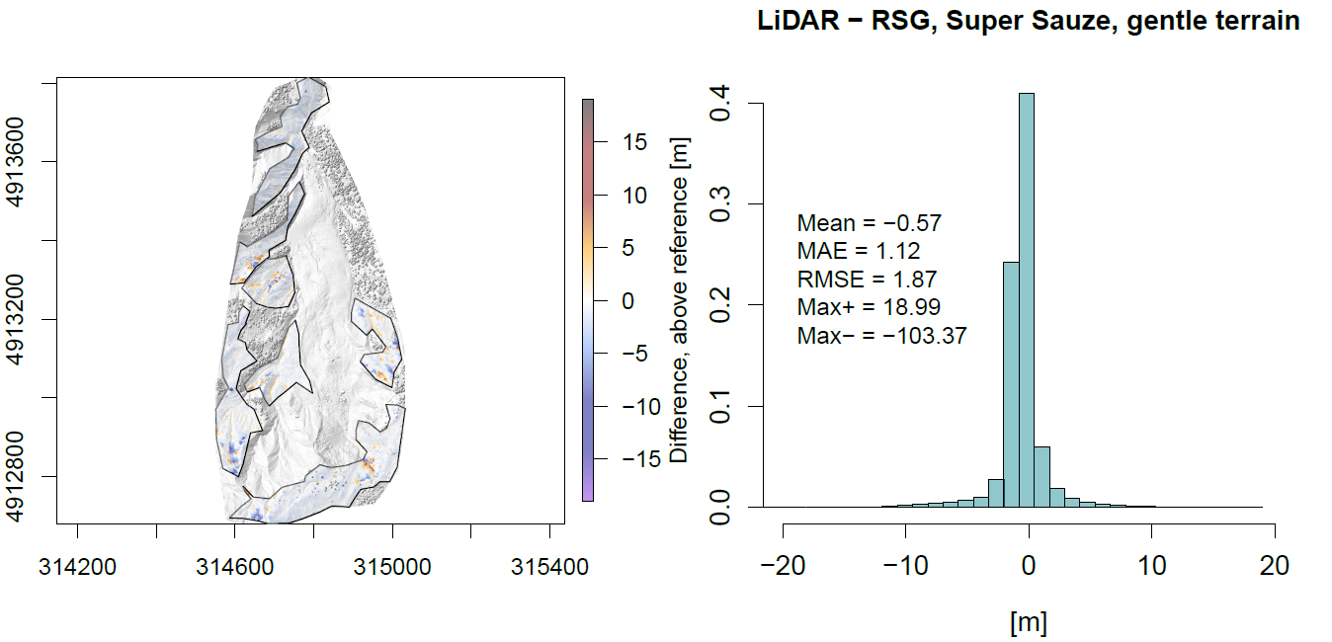
1. MOTIVATION
2. STUDY SITE /DATA
3. PROCESSING
4. RESULTS
5. DISCUSSION/PERSPECTIVES
RESULTS – QUANTITATIVE COMPARISON (SUPER SAUZE LANDSLIDE)
  ► RSG is a little bit worth here than LPS, probably due to residuals of the bias compensation

Slide 23
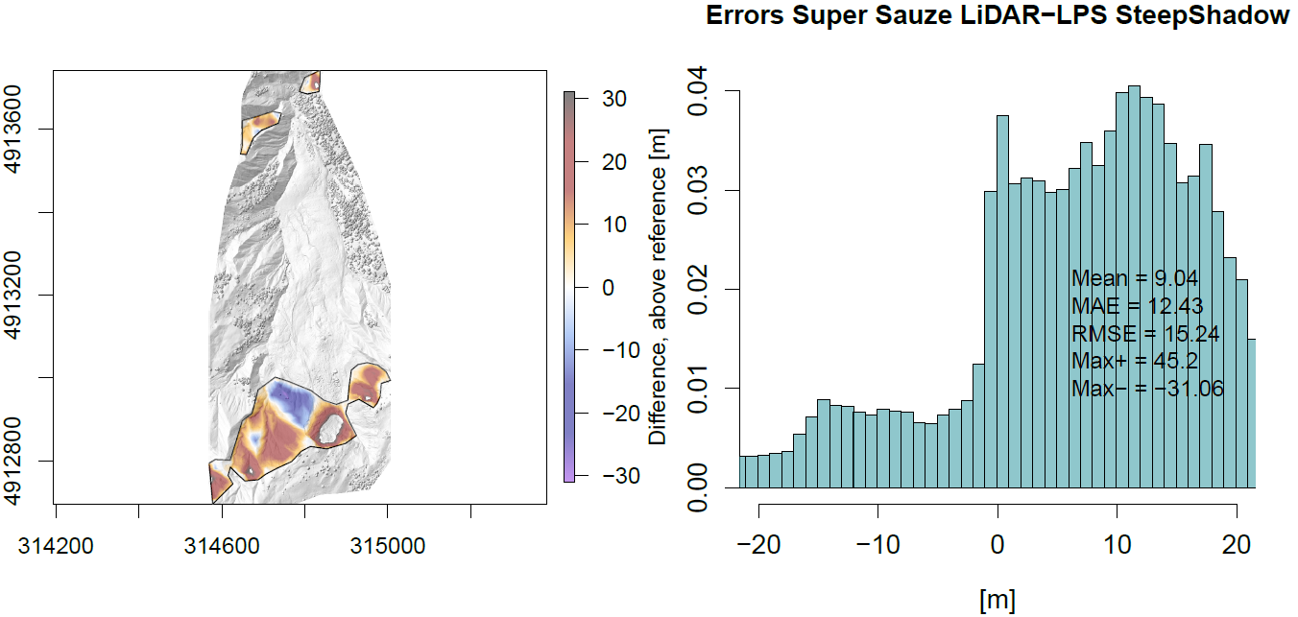
1. MOTIVATION
2. STUDY SITE /DATA
3. PROCESSING
4. RESULTS
5. DISCUSSION/PERSPECTIVES
RESULTS – QUANTITATIVE COMPARISON (SUPER SAUZE LANDSLIDE)
  ► LPS fails in steep slopes and shaded zones

Slide 24
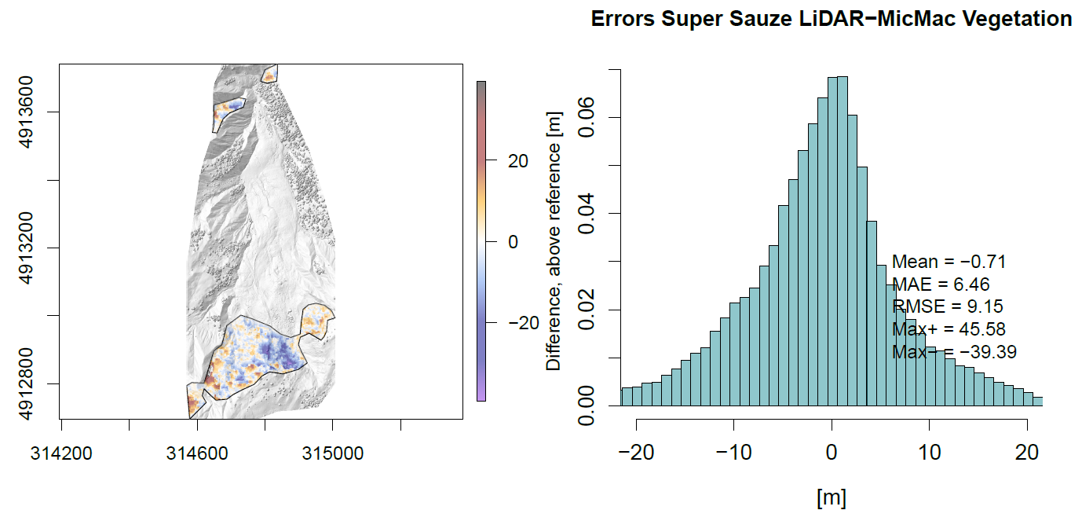
1. MOTIVATION
2. STUDY SITE /DATA
3. PROCESSING
4. RESULTS
5. DISCUSSION/PERSPECTIVES
RESULTS – QUANTITATIVE COMPARISON (SUPER SAUZE LANDSLIDE)
  ► MicMac is more more robust

Slide 25
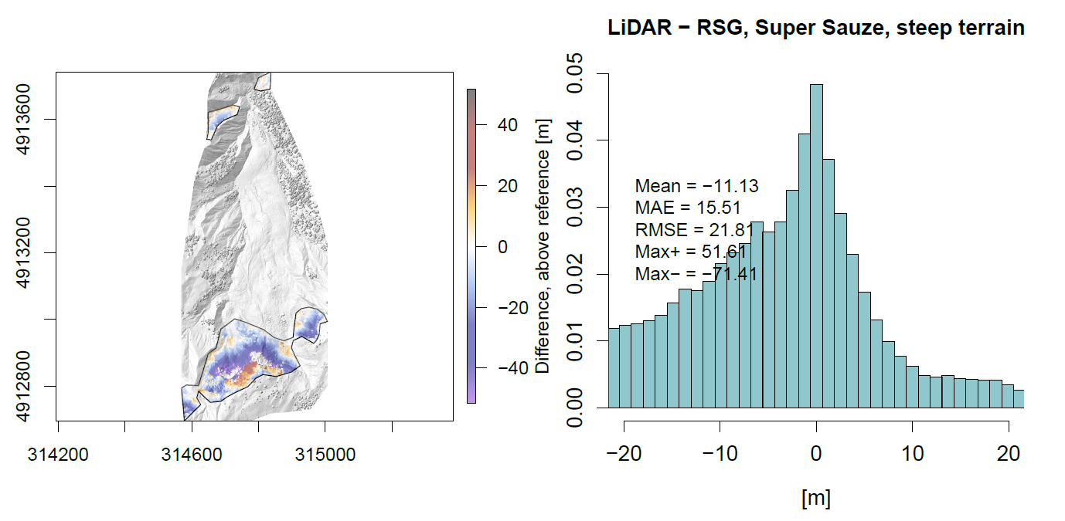
1. MOTIVATION
2. STUDY SITE /DATA
3. PROCESSING
4. RESULTS
5. DISCUSSION/PERSPECTIVES
RESULTS – QUANTITATIVE COMPARISON (SUPER SAUZE LANDSLIDE)
  ► Also complete failure of RSG

Slide 26
1. MOTIVATION
2. STUDY SITE /DATA
3. PROCESSING
4. RESULTS
5. DISCUSSION/PERSPECTIVES
RESULTS – SUMMARY
  ► MicMac is more robust, probably as accurate as LPS and RSG but it remains difficult to fully exploit this without capabilities for refinement of the sensor model and sparse documentation
  ► Correction after DSM generation can be a solution to quantify elevation changes but not for measuring horizontal displacement which needs aligned orthophotos
  ►LPS is not the most accurate in terms of matching but provides the most advanced capabilities for bundle block adjustment
  ► Crucial aspect for multi-temporal analysis
  ► RSG’s matching algorithm seems to be the most adapted for urban areas

Slide 27
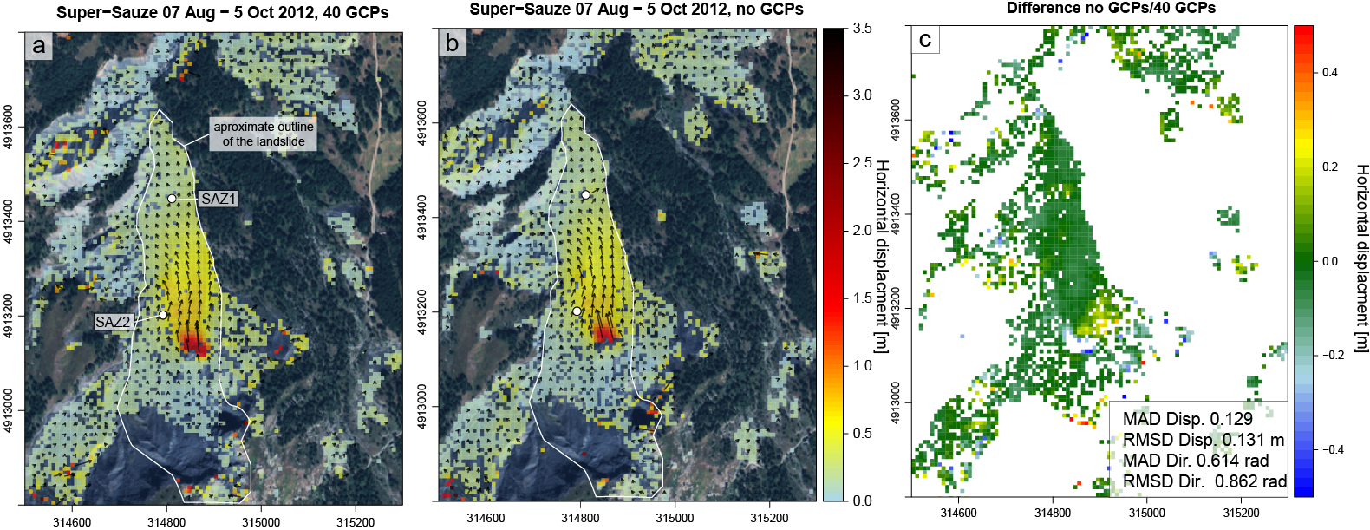
1. MOTIVATION
2. STUDY SITE /DATA
3. PROCESSING
4. RESULTS
5. DISCUSSION/PERSPECTIVES
RESULTS – SUMMARY
 | SAZ1 |  |  | SAZ2
 | GNSS | Image correlation |  | GNSS | Image correlation
 |  | 40 GCPs | no GCPs |  | 40 GCPs | no GCPs
E | 0.07 | 0.10 | 0.07 | 0.15 | 0.13 | 0.17
N | 0.23 | 0.23 | 0.22 | 0.58 | 0.46 | 0.45
Total horizontal | 0.24 | 0.25 | 0.23 | 0.60 | 0.48 | 0.48

Slide 28
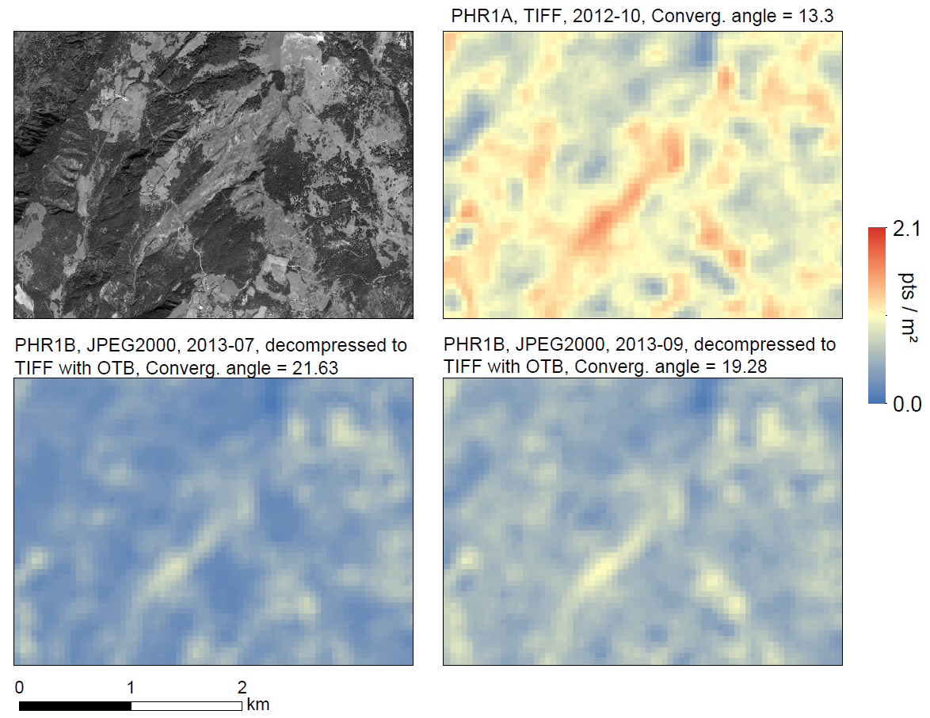
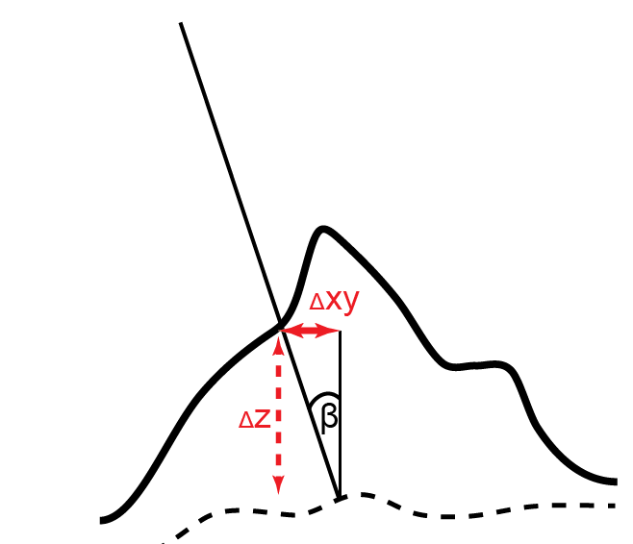
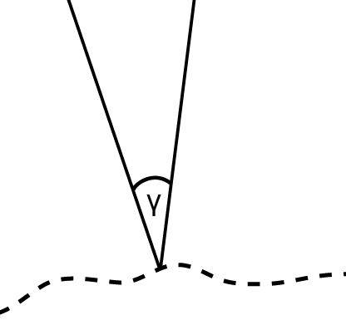
1. MOTIVATION
2. STUDY SITE /DATA
3. PROCESSING
4. RESULTS
5. DISCUSSION/PERSPECTIVES
PERSPECTIVES – TIME SERIES PROCESSING
What is the best acquisition strategy for this application?
► Low incidence angle β
► Convergence angle
10 < γ <15
► Decompression of JPEG2000 to TIFF before processing
DSM point density with from three stereo-pairs

Slide 29
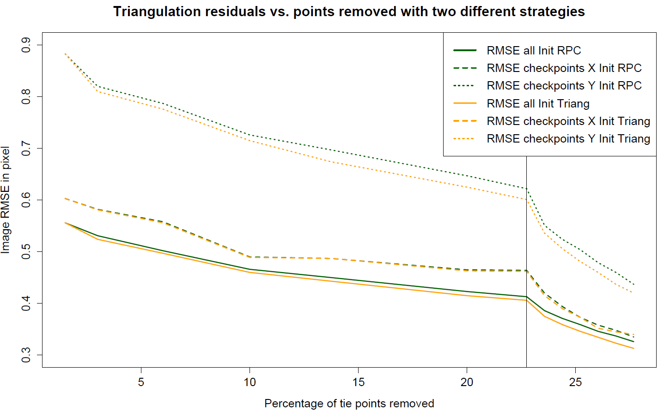
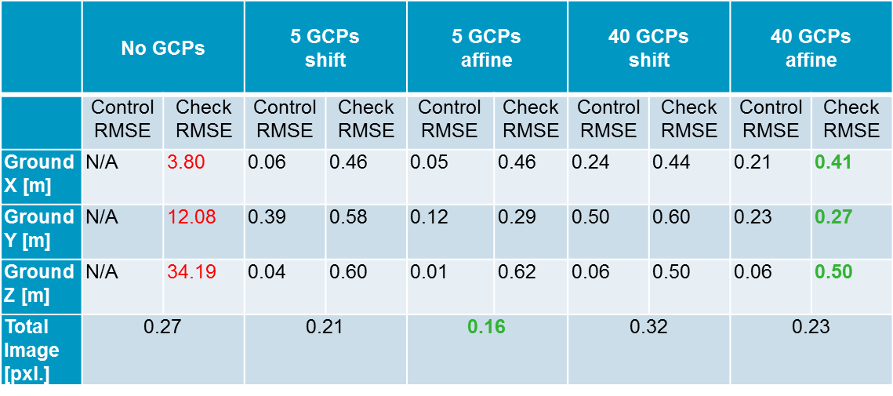
1. MOTIVATION
2. STUDY SITE /DATA
3. PROCESSING
4. RESULTS
5. DISCUSSION/PERSPECTIVES
PERSPECTIVES – TIME SERIES PROCESSING
How to minimize offset?
Image RMSE in pixel
Percentage of tie points removed
  ► In Green: Triangulations restarts each time from RPF sensor model
  ► In Orange: Each triangulations restarts from previous triangulation

Slide 30
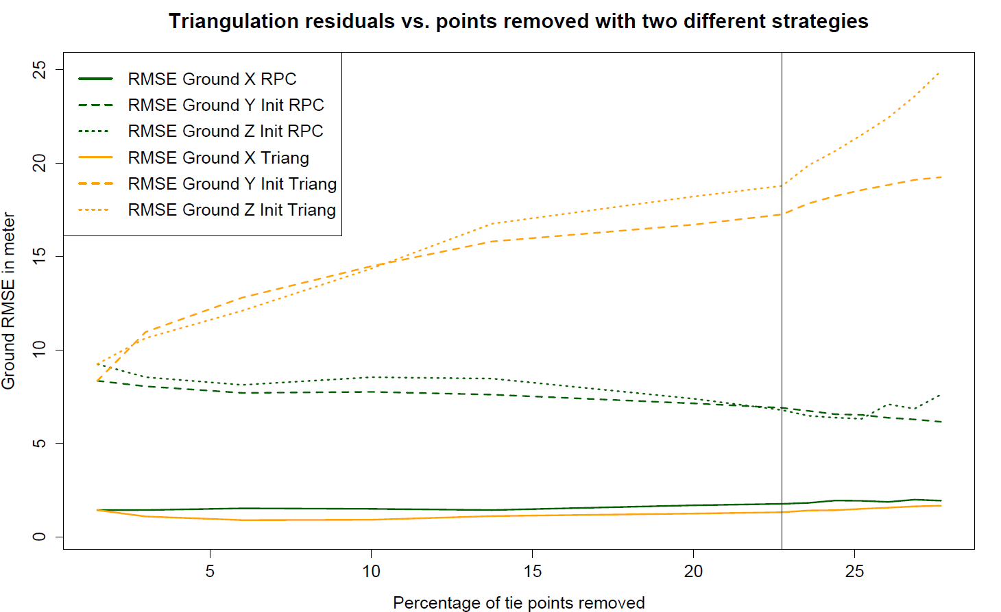
1. MOTIVATION
2. STUDY SITE /DATA
3. PROCESSING
4. RESULTS
5. DISCUSSION/PERSPECTIVES
PERSPECTIVES – TIME SERIES PROCESSING
How to minimize offset?
Ground RMSE in meter
Percentage of tie points removed
  ► In Green: Triangulations restarts each time from RPF sensor model
  ► In Orange: Each triangulations restarts from previous triangulation
  ► Leads to a propagation and increase of the bias with each iteration

Slide 31
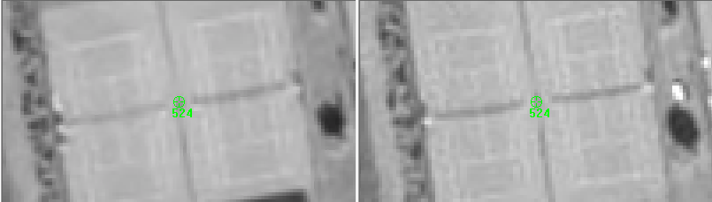
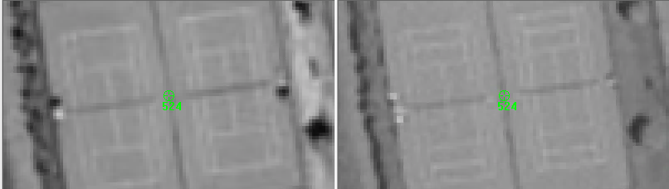
1. MOTIVATION
2. STUDY SITE /DATA
3. PROCESSING
4. RESULTS
5. DISCUSSION/PERSPECTIVES
PERSPECTIVES – TIME SERIES PROCESSING
Different resampling techniques or atmospheric artifacts or … ???
  Pleiades 1A Oct 2012
  Pleiades 1B Sept 2013
  Pleiades 1A Aug 2012
  Pleiades 1B June 2014

Slide 32
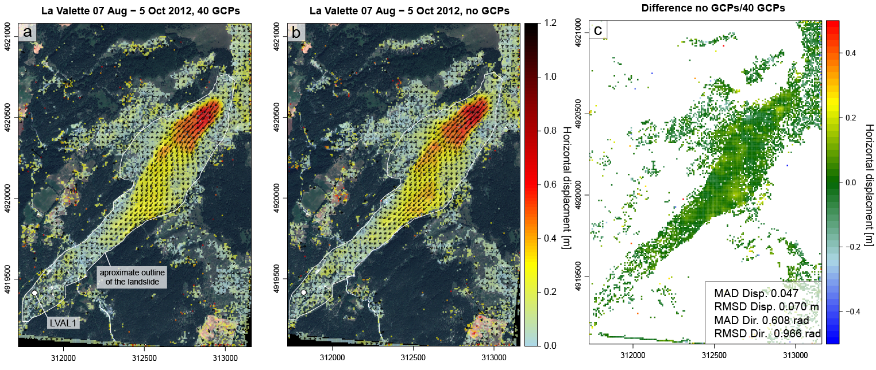
MERCI de VOTRE Attention !
Seminaire IPGP, 14 Nov
andre.stumpf@univ-brest.fr
Stumpf, A., Malet, J.-P., Allemand, P., & Ullrich, P. (2014). Surface reconstruction and landslide displacement monitoring with Pléiades VHR satellite images. ISPRS Journal of Photogrammetry and Remote Sensing, 95, 1–12.

Slide 33
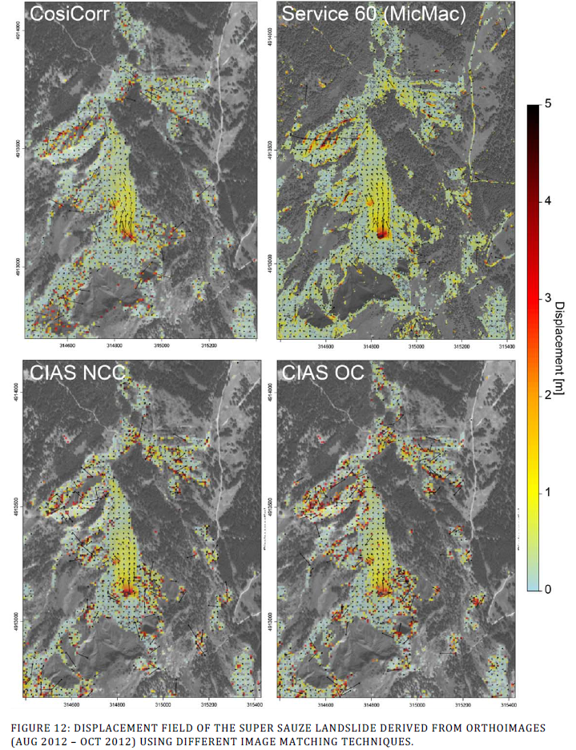
1. MOTIVATION
2. STUDY SITE /DATA
3. PROCESSING
4. RESULTS
5. DISCUSSION/PERSPECTIVES
PERSPECTIVES – TIME SERIES PROCESSING
Towards a use of VHR satellite images for monitoring at a regional scale?
How can time-series of VHR images be jointly exploited?
  joint filtering of stacked displacement fields for noise removal?
  a kind of small baseline approach?
  Implementation of the processing chain with open-source tools (MicMac,OTB)
MicMac correlator seems more robust to decorrelation in areas with high displacement
Possibility to use smaller window size allows capture more spatial variation better

Slide 34
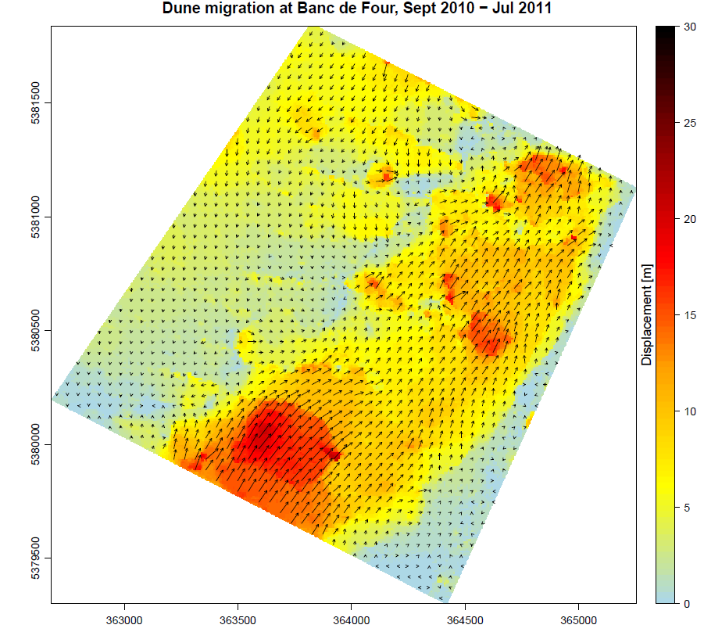
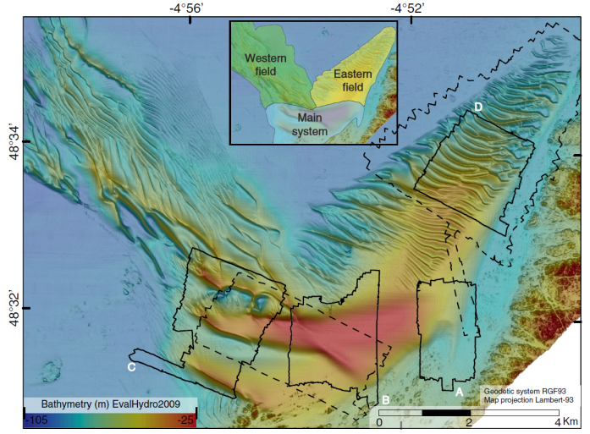
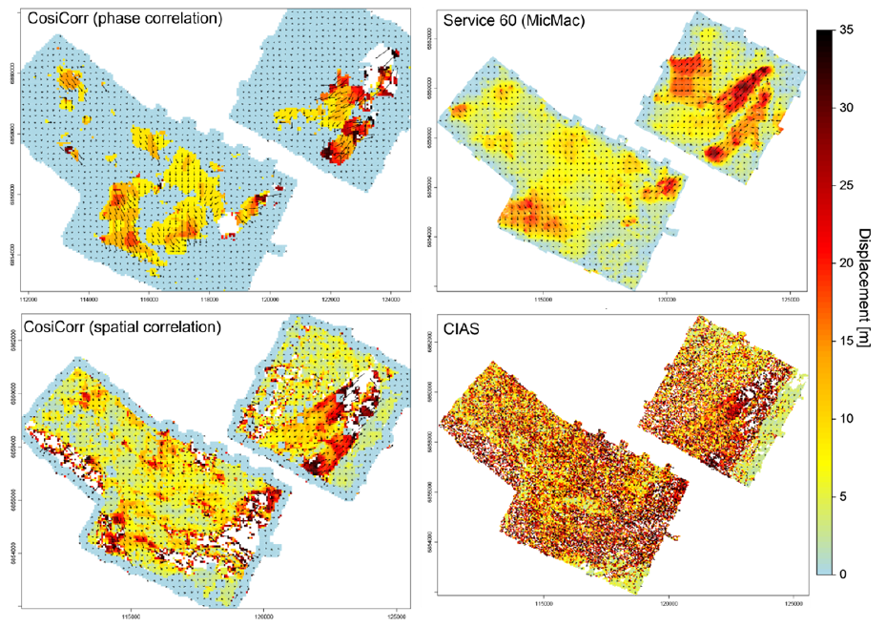
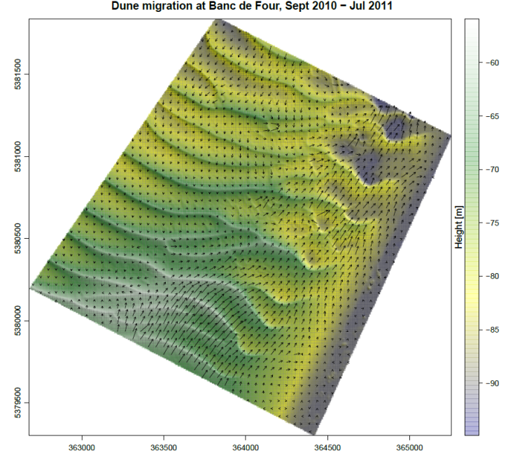
1. MOTIVATION
2. STUDY SITE /DATA
3. PROCESSING
4. RESULTS
5. DISCUSSION/PERSPECTIVES
PERSPECTIVES – MARINE DOMAIN
Tracking of sub-marine dune migration and sediment transfer at the Banc de Four

Slide 35
1. MOTIVATION
2. STUDY SITE /DATA
3. PROCESSING
4. RESULTS
5. DISCUSSION/PERSPECTIVES
RESULTS – SUBPIXEL IMAGE CORRELATION (AFTER POST-PROCESSING)
 | LVAL1
 | GNSS | Image correlation
 |  | 40 GCPs | no GCPs
E | 0.00 | -0.02 (-0.05) | -0.06 (-0.03)
N | -0.01 | 0.12 (0.21) | -0.06 (0.09)
Total horizontal | 0.01 | 0.12 (0.22) | 0.07 (0.09)

